Slide 1
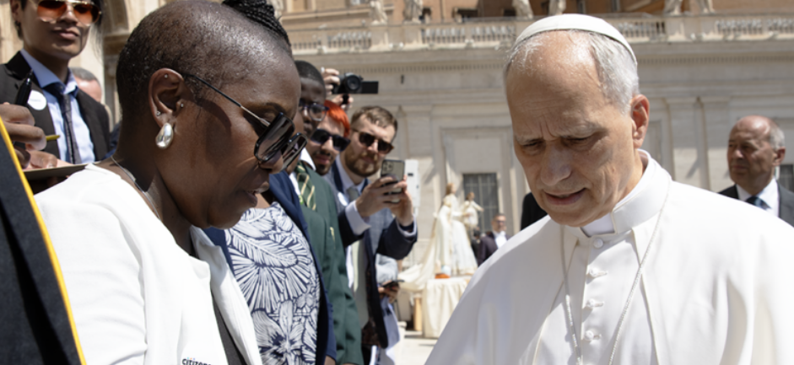
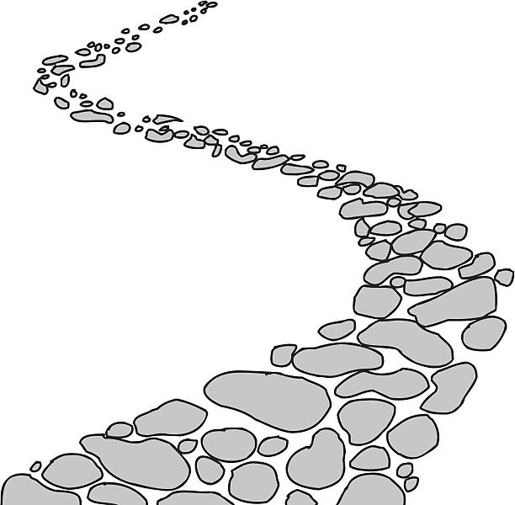

Walking the Path
~ Walking the Path of Hope ~
Monday 14th July 2025
Brentwood Diocese Education Service

Slide 2
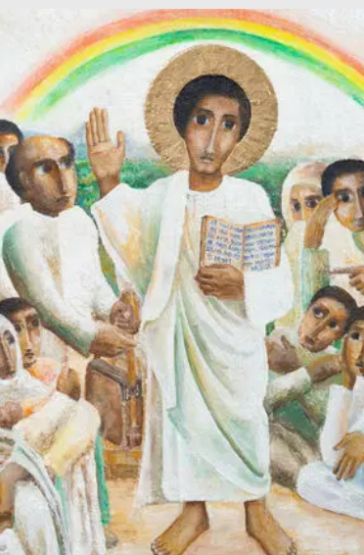
Reflection
“In the stillness of the dance
hold my hand.”
- CAFOD Jubilee Prayer
BDES

Slide 3
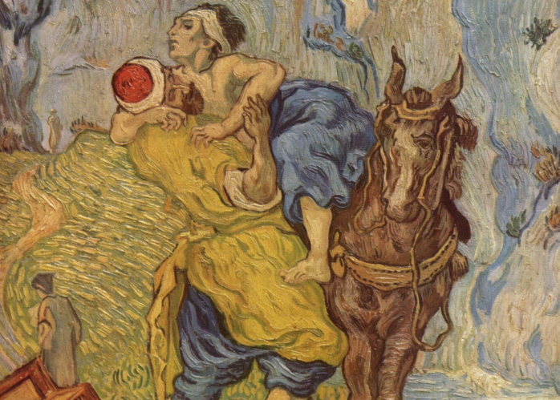
In Sunday’s Gospel Reading …
13th July 2025
In the Gospel of Luke,
Jesus is asked :
“Who is my neighbour?”
BDES

Slide 4

Preparing for World Youth Day 2027
“Let us train ourselves to recognise hope.”
- Pope Francis
BDES

Slide 5
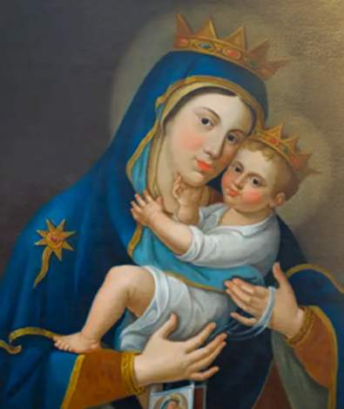
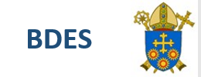
Feast of Our Lady of Mount Carmel : 16th July
Mount Carmel is where the prophet Elijah successfully challenged the priests of Baal, and references in the 12th century record a community of monks on the holy mountain. Despite continual difficulties, the community built a monastery and church dedicated to the Virgin Mary on Mount Carmel in 1263. Saint Louis, King of France, had visited Mount Carmel in 1254, and brought back six French hermits for whom he built a convent near Paris. Mount Carmel was conquered in 1291, the brothers were killed and the convent burned. The spread of the Carmelites in Europe is largely attributable to the work of Saint Simon Stock, whose relics can be seen in Aylesford Priory in Kent.
BDES
BDES

Slide 6
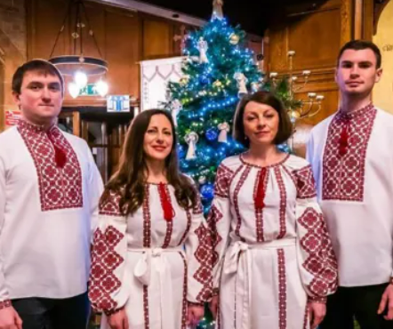
Rites of the Catholic Church # 5
THE UKRAINIAN GREEK CATHOLIC CHURCH
The Ukrainian Greek Catholic Church is a Byzantine Rite Eastern Catholic Church in full communion with the Holy See. In the UK, the Ukrainian Catholic Church is known as the Ukrainian Catholic Eparchy of the Holy Family of London. It was elevated to an eparchial status (equivalent to a diocese) in 2013. The current Eparch is Bishop Kenneth Nowakowski. The main cathedral in London is the Ukrainian Catholic Cathedral of the Holy Family.
The Byzantine Rite
BDES

Slide 7
Walking the Path
~ Walking the Path of Hope ~
Monday 14th July 2025
Brentwood Diocese Education Service

