Slide 1
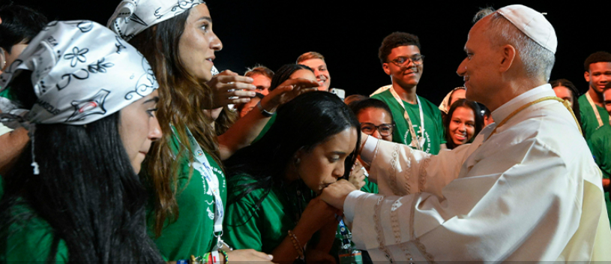
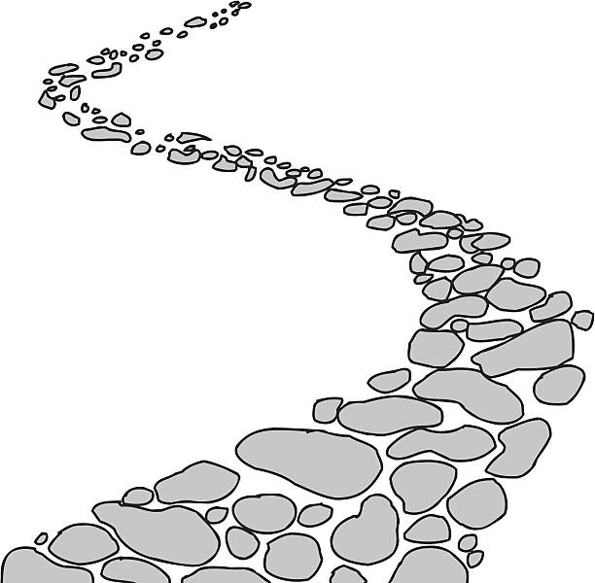

Walking the Path
~ Walking the Path of Hope ~
Monday 1st September 2025
Brentwood Diocese Education Service

Slide 2
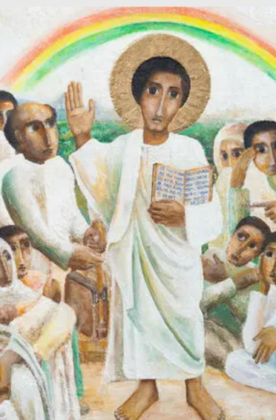
Reflection
“The icon interprets Jesus’ teaching in the synagogue of healing and liberation in Luke 4 : 16-21, which refers to Isaiah 61:1-2. This passage is particularly relevant to the Jubilee given its emphasis on bringing good news to those who are poor, and liberty to those who are captive or oppressed.”
- CAFOD Jubilee 2025: Exploring the Jubilee Icon
BDES

Slide 3
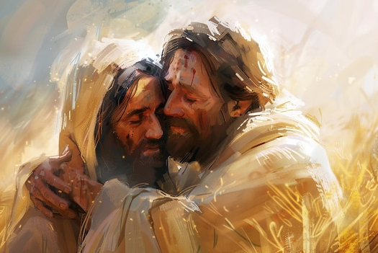
In Sunday’s Gospel Reading …
31st August 2025
In the Gospel of Luke,
Jesus tells us :
“You will be blessed.”
BDES

Slide 4

Preparing for World Youth Day 2027
“In Christ,
we are seeds of peace
and hope.”
Pope Leo,
4th August 2025
BDES

Slide 5
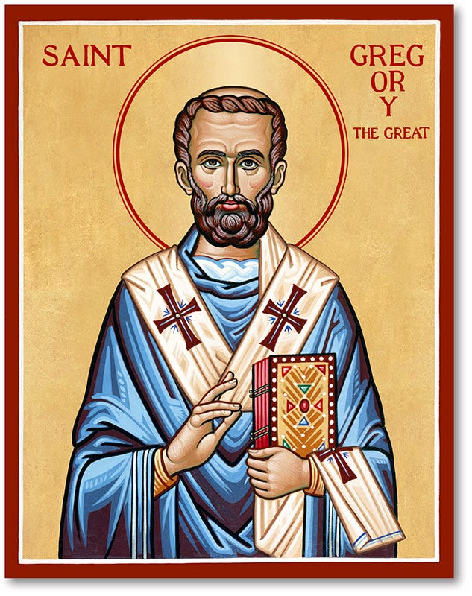
Feast of St Gregory the Great : 3rd Sept.
Pope Gregory I (540-604) was responsible for the first recorded large-scale mission from Rome, to convert the pagan Anglo-Saxons to Christianity. He wrote more than any previous pope and is famous for his Dialogues. He is the patron saint of teachers and musicians, as the song form plainchant is named after him as the “Gregorian chant”.
BDES

Slide 6
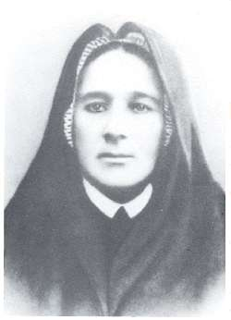
Blessed Eugenia Picco
Feast day : 7th September
She was born in the district of Milan called Crescenzaga in 1867. Her father was a famous musician and she was left with her grandparents while her parents were away, then her father disappeared and her home life was difficult. She ran away from home at the age of 20 and joined the Congregation of the Little Daughters of the Sacred Hearts of Jesus and Mary. She became their Superior General in 1911 and was a kind mother to all she met. She suffered ill health patiently, dying in 1921. Blessed Eugenia is is remembered as a model of virtue and a wise teacher.
BDES

Slide 7

YOUCAT WEEKLY SELECTION
#9: WHAT DOES GOD SHOW US ABOUT HIMSELF WHEN HE SENDS HIS SON TO US?
God shows us in Jesus Christ the full depth of his merciful love. He becomes a man like us. This shows us how far God’s love goes : He bears our whole burden. He walks every path with us. He is there in our abandonment, our sufferings, our fear of death. He is there when we can go no farther, so as to open up for us the door leading into life.
BDES

Slide 8
Walking the Path
~ Walking the Path of Hope ~
Monday 1st September 2025
Brentwood Diocese Education Service

