Slide 1
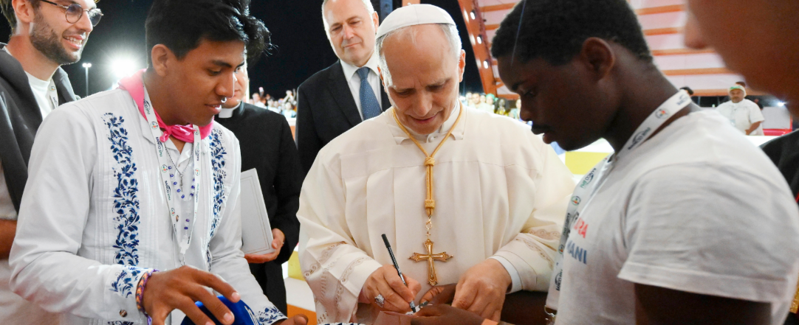


Walking the Path
~ Walking the Path of Hope ~
Monday 8th September 2025
Brentwood Diocese Education Service

Slide 2
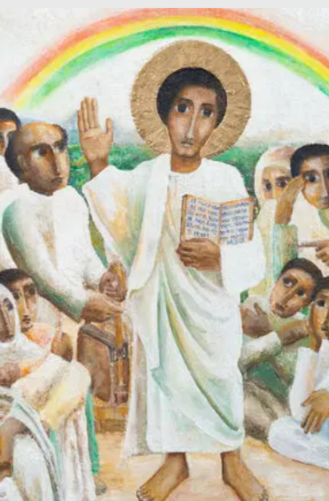
Reflection
“The icon captures the moment where Jesus reads from the scroll of Isaiah in the synagogue at Nazareth : “The Spirit of the Lord is upon me, because He has anointed me to proclaim good news to the poor. He has sent me to proclaim liberty to the captives and recovering of sight to the blind, to set at liberty those who are oppressed, to proclaim the year of the Lord’s favour.
- CAFOD Jubilee 2025: Exploring the Jubilee Icon
BDES

Slide 3

14th SEPTEMBER
BDES
BDES

Slide 4
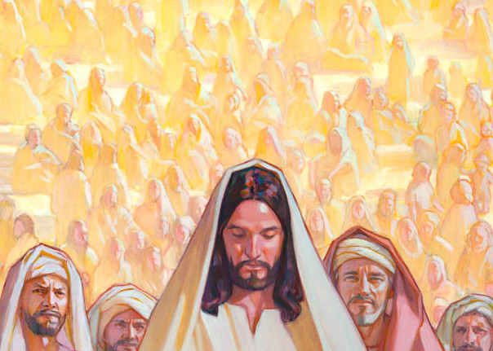
In Sunday’s Gospel Reading …
23rd Sunday in Ordinary Time 7th September 2025
In the Gospel of Luke,
we hear that:
“Great crowds accompanied Jesus.”
BDES

Slide 5
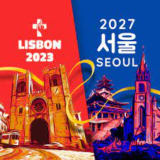
Preparing for World Youth Day 2027
“You will be the salt of the earth and the light of the world. You will be seeds of hope where you live.”
- Pope Leo,
August 2025
BDES

Slide 6
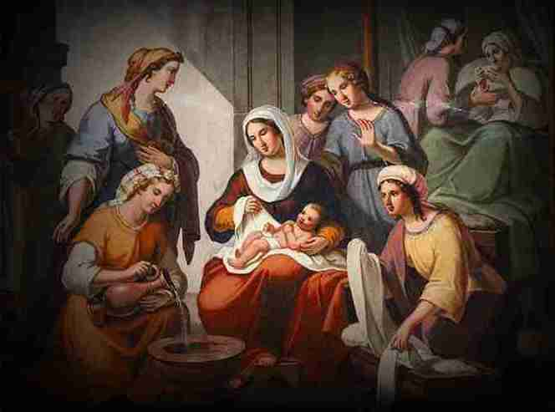
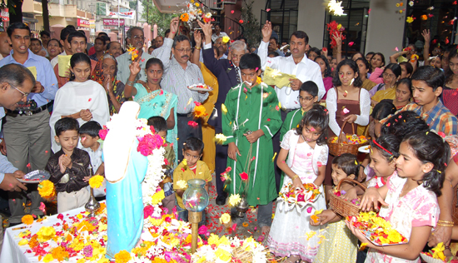
Nativity of the Virgin Mary : 8th September
This feast day celebrates the birth of the Blessed Virgin Mary, the mother of Jesus.
It is celebrated nine months after the feast of the Immaculate Conception (8th December), which teaches that Mary did not have the stain of original sin on her soul.
There are celebrations throughout September in different parts of the world.
In France, this time of year is celebrated as the season of ‘Our Lady of the Grape Harvest’ and in places in India there are also a range of customs, including holding festive meals and showering flowers on a statue of Mary.
BDES

Slide 7
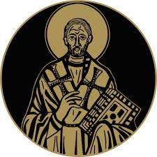
St John Chrysostom
13th September
St John, who lived 347-407 AD in Antioch, was known as Chrysostomos (“Golden Mouth”) on account of his gift of eloquence. He was a gifted public speaker at the Golden Church of Antioch, interpreting Scripture and preaching compassion for the poor. He became Archbishop of Constantinople in 397, reformed the
clergy and founded several hospitals. He lived a simple life but made political enemies on account of his preaching and was banished. One of his celebrated teachings is that : xxxxxx “prayer without almsgiving is unfruitful.”
BDES

Slide 8

YOUCAT WEEKLY SELECTION
#328 : HOW CAN THE INDIVIDUAL CONTRIBUTE TO THE COMMON GOOD?
Working for the common good means assuming responsibility for others.
The common good must be the business of everyone.
This happens when everybody gets involved in their particular surroundings – family, neighbourhood, workplace – and takes responsibility.
BDES

Slide 9
Walking the Path
~ Walking the Path of Hope ~
Monday 8th September 2025
Brentwood Diocese Education Service

