Slide 1
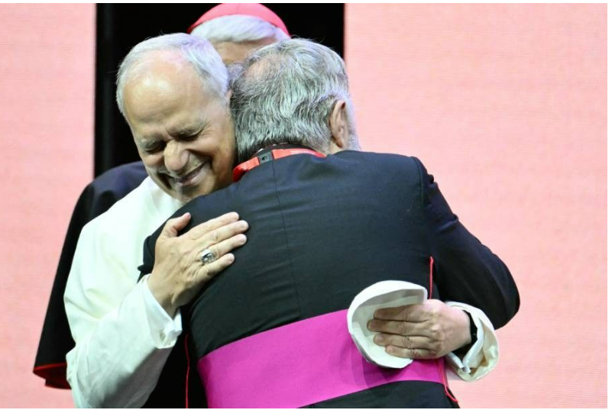


Walking the Path
~ Walking the Path of Hope ~
Monday 15th September 2025
Jubilee of Consolation
Brentwood Diocese Education Service

Slide 2
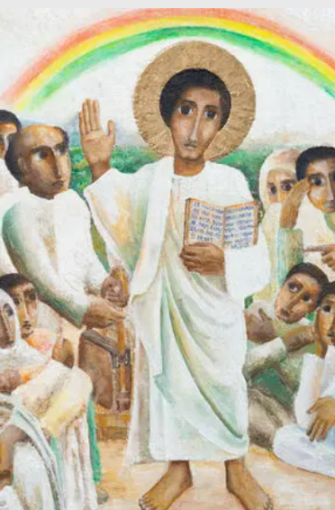
Reflection
The icon portrays Jesus faithfully in the Northern Ethiopian tradition and is consistent with Ethiopian facial expressions and clothing, such as the women's head coverings. The gold used for Jesus’ halo is paint rather than gold leaf; the artist using what he had available in an area where there is conflict and drought.
In the icon, men and women, the old and the young all gather together as sign that the good news is for everyone.
This gathering is outside of the synagogue’s walls, in an open space, beyond segregation and division.
The rainbow in the background a symbol of hope and light, even in the darkness.
- CAFOD Jubilee 2025: Exploring the Jubilee Icon
BDES

Slide 3
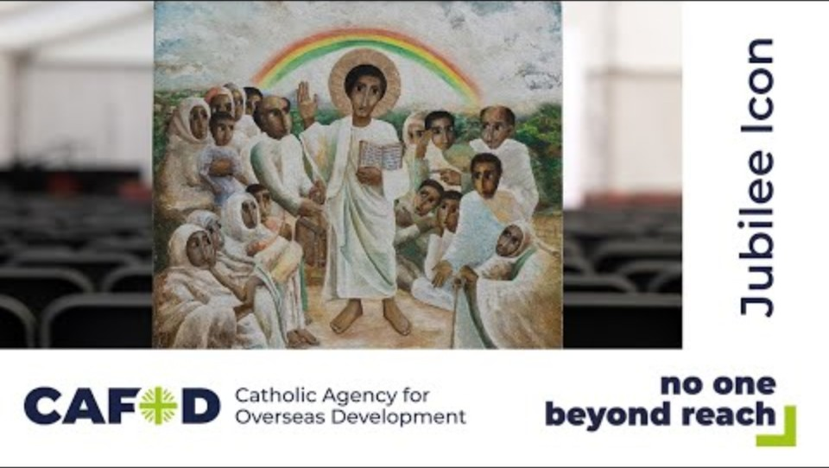
Video Reflection
The icon portrays Jesus faithfully in the Northern Ethiopian tradition and is consistent with Ethiopian facial expressions and clothing, such as the women's head coverings.
Take a moment now to explore the meaning contained within the icon from the artist himself by watching the video by clicking on the video link.
- CAFOD Jubilee 2025: Exploring the Jubilee Icon
BDES

Slide 4
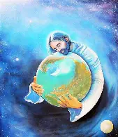
In Sunday’s Gospel Reading …
“For God so loved the world that he gave his one and only Son.”
BDES

Slide 5
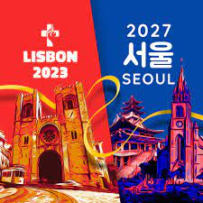
Preparing for World Youth Day 2027
“Aspire to great things, aspire to holiness.”
Pope Leo,
4th August 2025
BDES

Slide 6
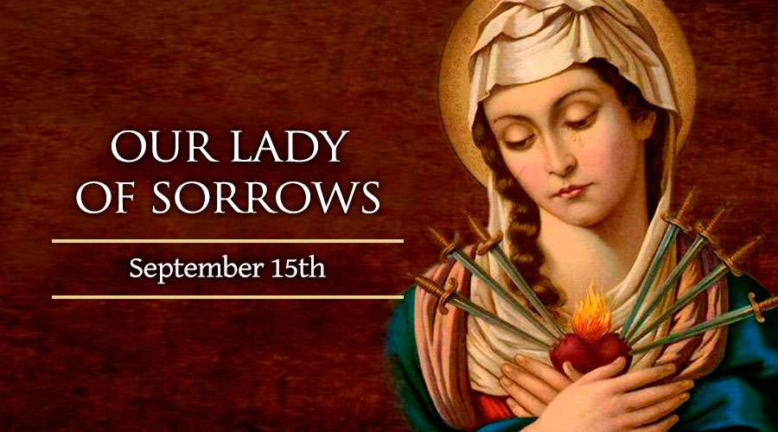
Our Lady of Sorrows
15th September
Our Lady of Sorrows is the Feast on the day immediately after the Exaltation of the Holy Cross and commemorates the great union of Our Lady with Our Saviour.
The title Our Lady of Sorrows, honours the trials that the Mother of the “Suffering Servant” (Isaiah 52:13–53:12) faced, the struggles of her mission through her Son’s mission are remembered today.
BDES

Slide 7
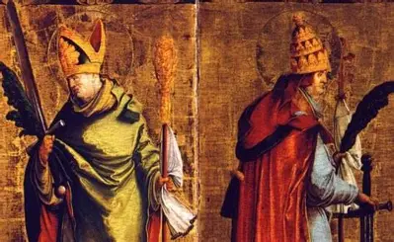
Saints Cornelius and Cyprian
16th September
Cornelius was made bishop of the Church in Rome in 251 and, with the help of Cyprian, established his authority there until the emperor Gallus sent him into exile and he died in Civitavecchia in 253. He is buried in Rome.
Cyprian spent most of his life practicing the law and after he converted to Christianity, was made bishop of Carthage in 249. The church saw some troubled times, and in order to continue to support the church, Cyprian went into hiding after the persecution of emperor Decius. In 258, the persecution of emperor Valerian began and Cyprian was exiled and then executed.
He is known for his illuminating letters which are valuable for not only doctrine, but also for their historical contribution to understanding the life of those in constant peril, but with a determination and ultimate commitment to their faith.
BDES

Slide 8
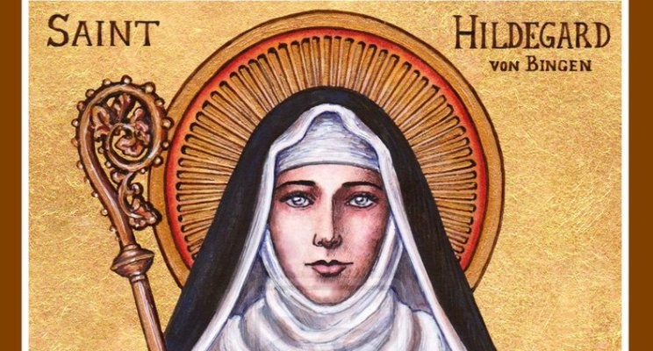
St. Hildegard of Bingen:
17th September
Hildegard was born in 1098 and experienced visions from a young age. She joined a Benedictine convent, of which she became the abbess. She had extraordinary gifts and as well as being remembered as a visionary, she achieved fame as a scholar, a writer, a composer, a philosopher and a mystic. She wrote theological, botanical and medical texts as well as letters, hymns, antiphons, and poems. She is one of the few known composers of the Middle Ages to have written both the music and the words. She wrote the earliest surviving mystery play and invented a language; she is seen as the founder of scientific natural history in Germany. On 7th October 2012, Pope Benedict XVI named her a Doctor of the xxx Church, in recognition of “her holiness of life and the originality of her teaching.”
BDES

Slide 9
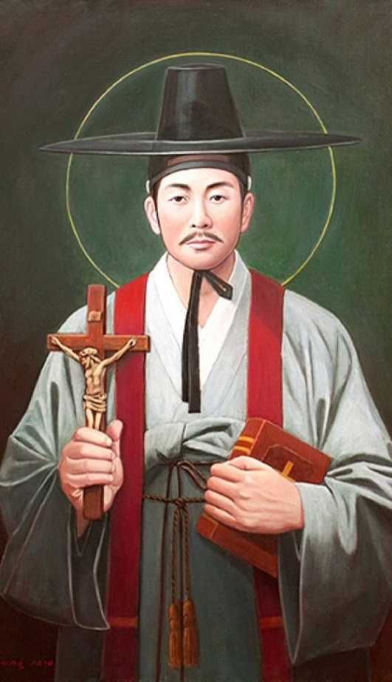
St Andrew Kim Taegon:
20th September
St Andrew Kim Taegon was the first Korean-born Catholic priest and is the patron saint of Korean clergy.
He was baptised at the age 15 and joined the seminary in Macau. He then became a priest and returned to Korea.
Christianity was persecuted in his home country and at the age of 25 he was martyred near Seoul.
He was canonised in 1984 during a visit of Pope John Paul II to Korea and his feast day is celebrated on 20th September.
.
BDES

Slide 10

YOUCAT WEEKLY SELECTION
#11 DOES SACRED SCRIPTURE SPEAK
ABOUT A WAY TO HAPPINESS?
We become happy by trusting in Jesus’ words in the Beatitudes. (CCC 1716) The Beatitudes are at the heart of Jesus' preaching. They take up the promises made to the chosen people since Abraham. The Beatitudes fulfill the promises by ordering them no longer merely to the possession of a territory, but to the Kingdom of heaven:
Read the Beatitudes in Mattews 5:13-12.
BDES

Slide 11
Walking the Path
~ Walking the Path of Hope ~
Monday 15th September 2025
Brentwood Diocese Education Service

