Slide 1
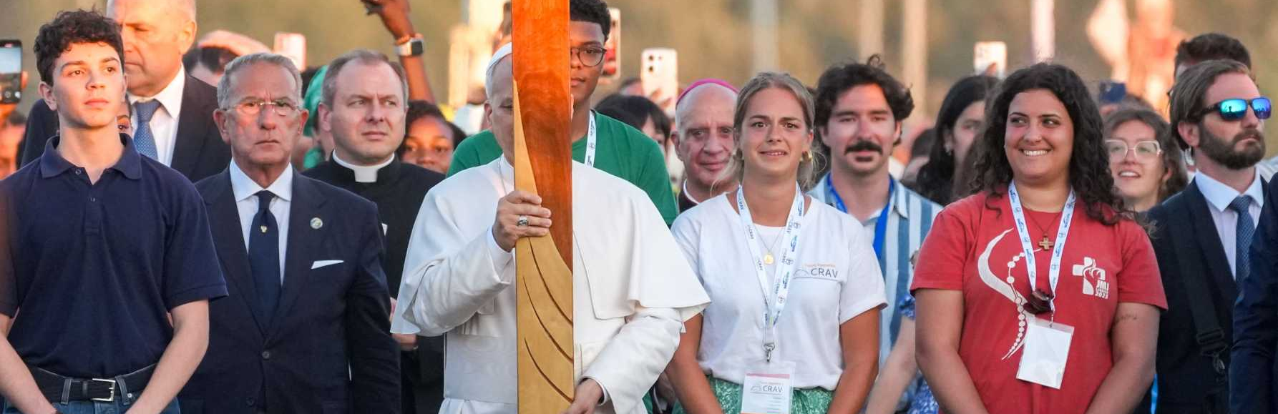
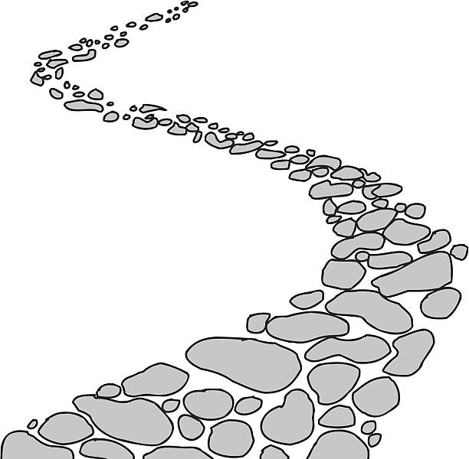

Walking the Path
~ Walking the Path of Hope ~
Monday 22nd September 2025
Brentwood Diocese Education Service

Slide 2
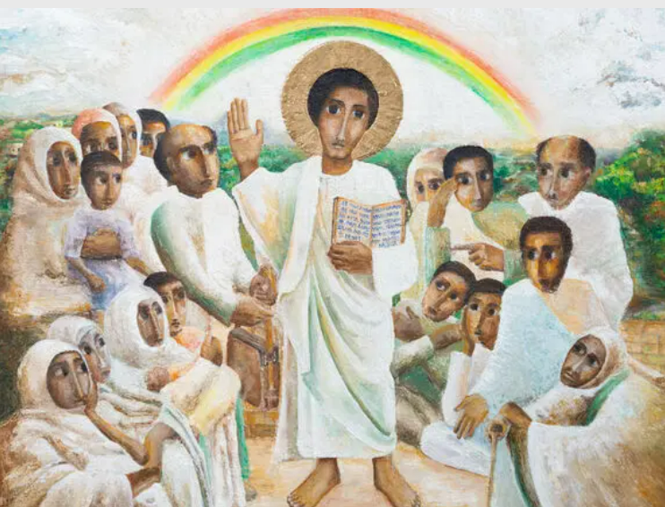
Reflection
Look at the crowd gathered to listen to Jesus. It includes men, women and children. Old and young. Their eyes are fixed on Jesus, they are engaged with the Word of God.
- CAFOD Jubilee 2025 : Exploring the Jubilee Icon
BDES

Slide 3

Evangelli Gaudium Sunday
The Joy of the Gospel
BDES
BDES

Slide 4

In Sunday’s Gospel Reading …
25th Sunday in Ordinary Time 21st September 2025
In the Gospel of Luke,
Jesus tells us that
“No one can serve two masters.”
BDES

Slide 5

Preparing for World Youth Day 2027
“Be courageous in your choices and in your friendships.”
- Pope Leo,
August 2025
BDES

Slide 6
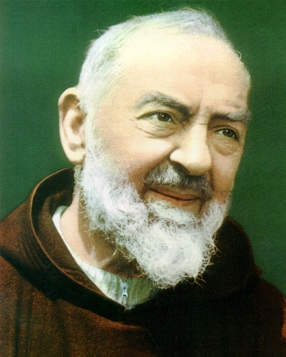
Saint Pius of Pietrelcina (Padre Pio): 23rd September
Francesco Forgione, better known as Padre Pio and also Saint Pius of Pietrelcina was born on 25 May 1887 and died on 23rd September 1968. He was a member of the Italian Franciscan Capuchin order.
Padre Pio became famous for exhibiting stigmata for most of his life, thereby generating much interest and controversy. This means that he experienced bodily marks, pain, and bleeding in locations corresponding to the crucifixion wounds of Jesus.
He was beatified (made Blessed) in 1999. After consideration of Padre Pio's virtues and ability to do good even after his death, including discussion of healings attributed to his intercession, John Paul II declared Padre Pio a saint on 16th June 2002. An estimated 300,000 people attended the canonization ceremony in Rome.
BDES

Slide 7
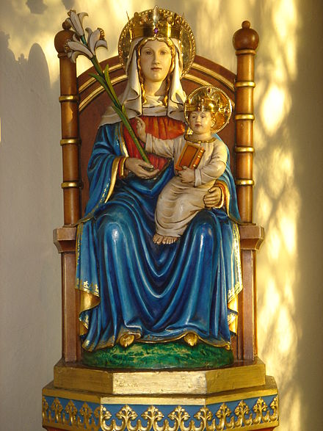
0
Feast Day of Our Lady of Walsingham
Walsingham has had a famous shrine to Our Lady since 1061. It was one of the great places of pilgrimage in the Middle Ages.
In a Marian apparition the Blessed Virgin Mary fetched Richeldis’ soul from England to Nazareth to show the house where the Holy Family once lived and in which the Annunciation of Archangel Gabriel occurred. Richeldis was given the task of building a replica house in her village, in England which came to be known as the "Holy House", and later became both a shrine and a focus of pilgrimage to Walsingham. In 1538 the King’s Commissioners destroyed the Shrine and burned the statue of Our Lady.
In 1897 the Sanctuary of Our Lady of Walsingham was restored and rebuilt, and pilgrimages began again.
24th September
BDES

Slide 8
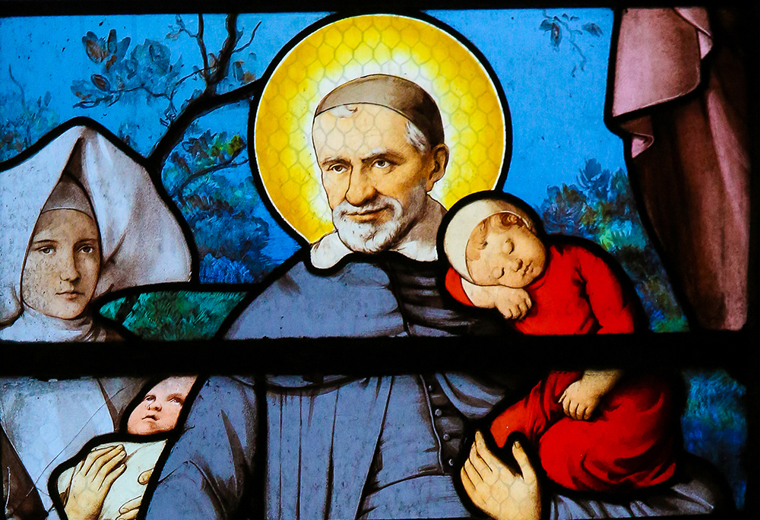
St. Vincent de Paul:
27th September
Vincent was born in Gascony, France in 1581 and was ordained a priest in 1600. He dedicated his life to serving the poor and in 1622 was appointed as chaplain to the galleys, specifically ministering to the galley slaves imprisoned in Paris. He became the superior of a new order known as the Congregation of the Mission, which we now call the Vincentians. Priests of the order take vows of poverty and devote themselves to care for the poor. Vincent conducted retreats for priests to help them develop spiritually, established seminaries to train them and also founded the Daughters of Charity. He died in 1660 and was canonised in 1737.
BDES

Slide 9

YOUCAT WEEKLY SELECTION
#165 WHY DO WE SAY “AMEN” TO THE PROFESSION OF OUR FAITH?
We say Amen -“Yes” - to the profession of our faith
because God appoints us witnesses to the faith.
Anyone who says Amen assents freely and gladly to God’s work in creation and redemption.
The Hebrew word amen comes from a family of words that mean both “faith” and “steadfastness, reliability, fidelity”.
“He who says amen writes his signature” (St. Augustine).
BDES

Slide 10
Walking the Path
~ Walking the Path of Hope ~
Monday 22nd September 2025
Brentwood Diocese Education Service

