Slide 1
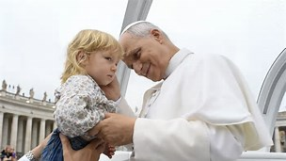
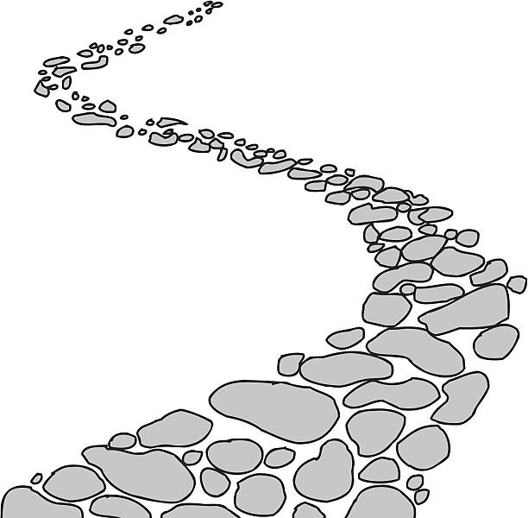

Walking the Path
~ Walking the Path of Hope ~
Monday 29th September 2025
Brentwood Diocese Education Service

Slide 2
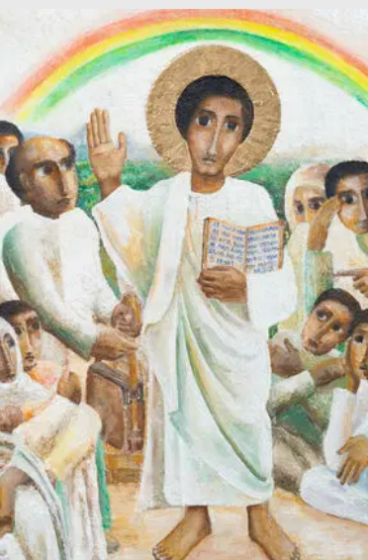
Reflection
As we turn our attention to different features of the icon in more detail, we concentrate on Jesus’ gaze.
Jesus looks out into the world. His gaze encompasses all people, not just this crowd, and his teaching is for all time.
He can also be interpreted to be looking directly at US wherever we are, wherever we find Him.
He is saying that His message is for us too.
- CAFOD Jubilee 2025: Exploring the Jubilee Icon
BDES

Slide 3


Slide 4
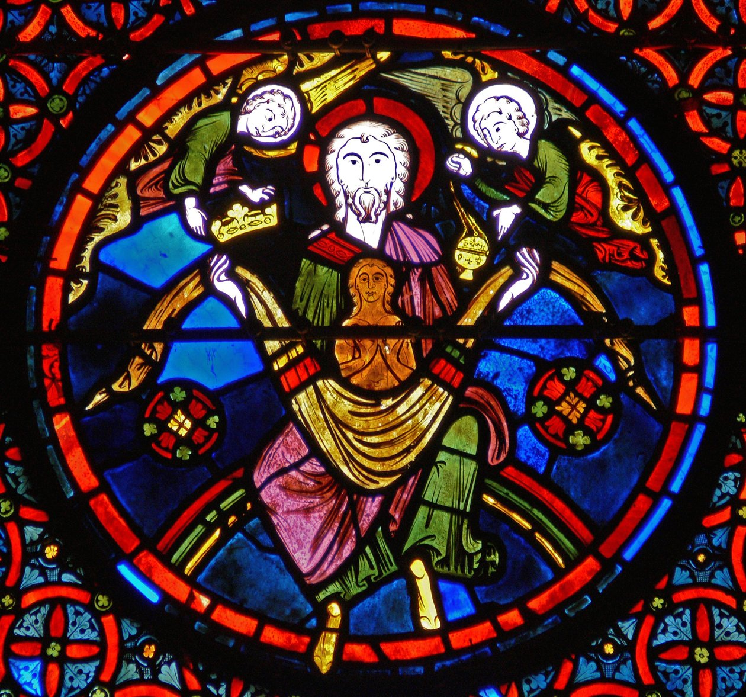
In Sunday’s Gospel Reading …
26th Sunday in Ordinary Time
28th September
“The angels carried him to Abraham’s side.”
BDES

Slide 5
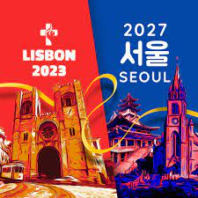
Preparing for World Youth Day 2027
“You will see the light of the Gospel grow every day .”
Pope Leo, August 2025 :
Message to Young People at the Jubilee of Youth
BDES

Slide 6
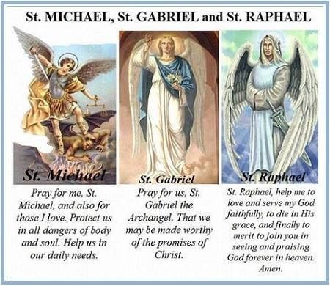
SS. Michael, Gabriel & Raphael
29th September
SS. Michael, Gabriel, and Raphael are the only angels named in Sacred Scripture and all three have important roles in the history of salvation.
BDES

Slide 7
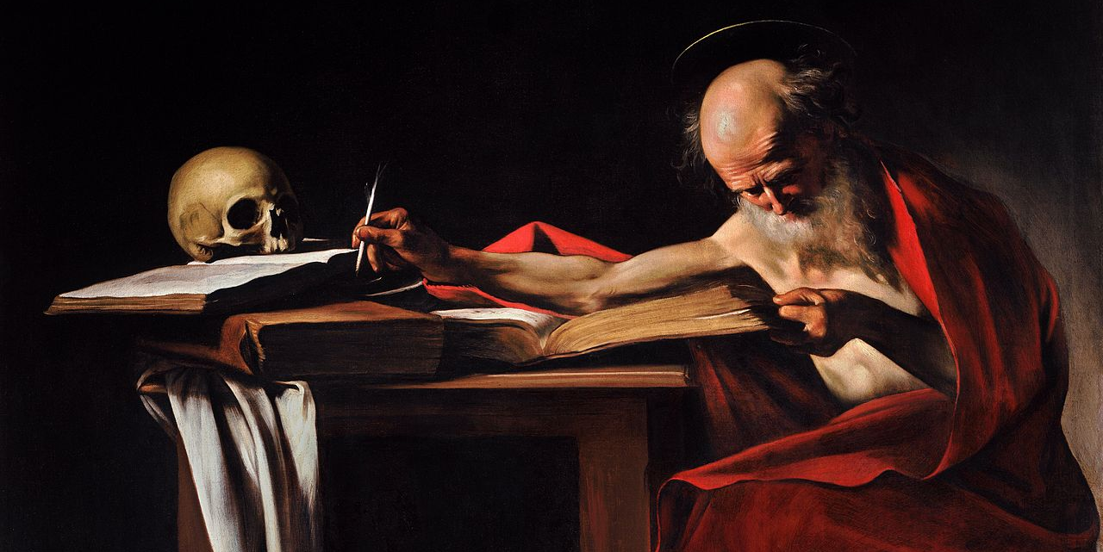
St Jerome translated the Bible from Hebrew and Greek into Latin.
____________________________________
Prayer of St. Jerome:
“O Lord,
you have given us
Your word as a light
to shine upon our path;
help us to meditate
on that word,
and follow its teaching,
that we may find in it
the light that shines
more and more
until the perfect day.”
Amen
St Jerome : 30th September
BDES

Slide 8
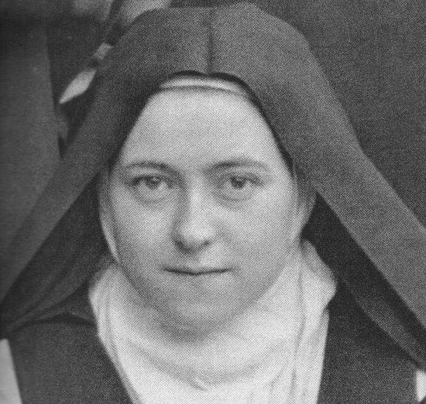
Saint Thérèse of Lisieux:
1st October
St Thérèse (1873-1897) is also known as Saint Thérèse of the Child Jesus and the Holy Face, and is one of the most popular Catholic saints in the history of the Church. In the Diocese of Brentwood , we have no fewer than four schools named after her, in Basildon,
Dagenham, Lexden and Rochford. She died when she was only 24 years old, but left a spiritual legacy of simplicity, practicality and common sense expressed in her “Little Way” :
“I will seek a means of getting to Heaven by a little way – a very short and very straight little way that is wholly new. I mean to try and find a lift by which I may be raised to God, for I am too tiny to climb the xxx steep stairway of perfection. Your arms, then, Jesus, are the lift which will raise me up to Heaven.”
BDES

Slide 9
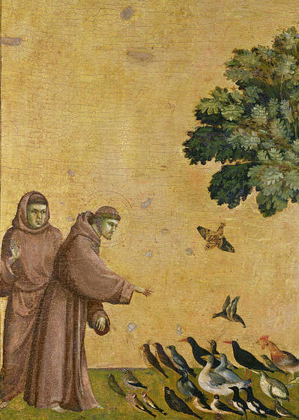
St Francis of Assisi: 4th October
St Francis is one of the most recognised and revered saints. He founded the Order of the Friars Minor (Franciscans) and the Order of St Clare, as well as an order for lay people.
He was born in the late 12th century in Italy of wealthy parents, living a good life, becoming a soldier and going on pilgrimage to Rome. He then chose to live a simple life, having lost interest in his former pastimes, and attracted many followers. The Pope agreed to the group being recognised by the Church. Francis travelled widely, to Egypt where he met the Sultan and to the Holy Land.
He created the first Nativity scene, using living animals. In 1224 Francis received the stigmata, dying on 3rd October 1226. He believed nature is the ‘mirror of God’ and was declared the patron saint xxxx of ecology in 1979.
BDES

Slide 10

YOUCAT WEEKLY SELECTION
#123 – WHAT IS THE TASK OF
THE CHURCH?
The Church’s task is to make the kingdom of God, which has already begun with Jesus, germinate and grow in all nations.
This means that we, as Church, must carry on what He started and act like He would act to do our part to bring about the Kingdom of God.
BDES

Slide 11
Walking the Path
~ Walking the Path of Hope ~
Monday 29th September 2025
Brentwood Diocese Education Service

