Slide 1
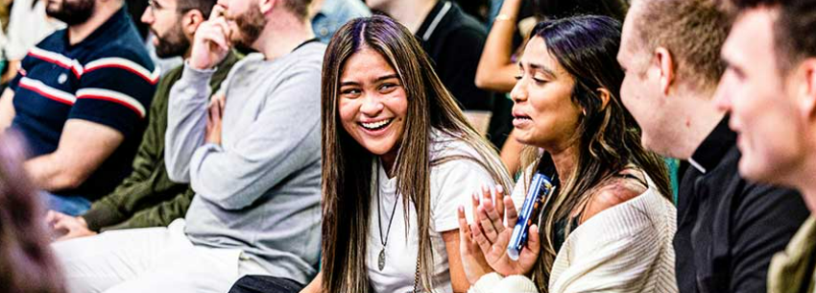
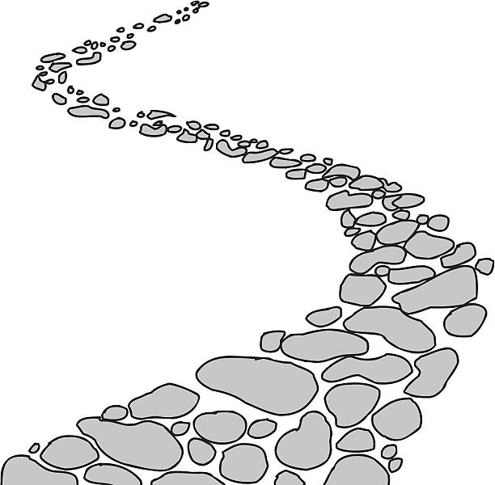

Walking the Path
~ Walking the Path of Hope ~
Monday 6th October 2025
Brentwood Diocese Education Service

Slide 2
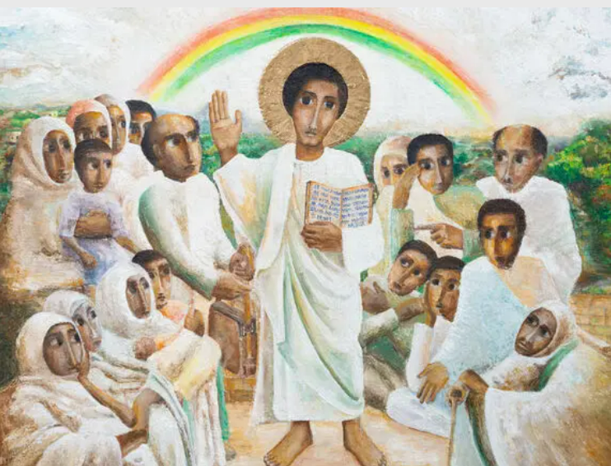
Reflection
Look at the crowd gathered to listen to Jesus.
The person with a stick at the front shows Jesus’ concern for those who are often overlooked in our society, such as the elderly, vulnerable and those living with a disability.
- CAFOD Jubilee 2025 : Exploring the Jubilee Icon
BDES

Slide 3
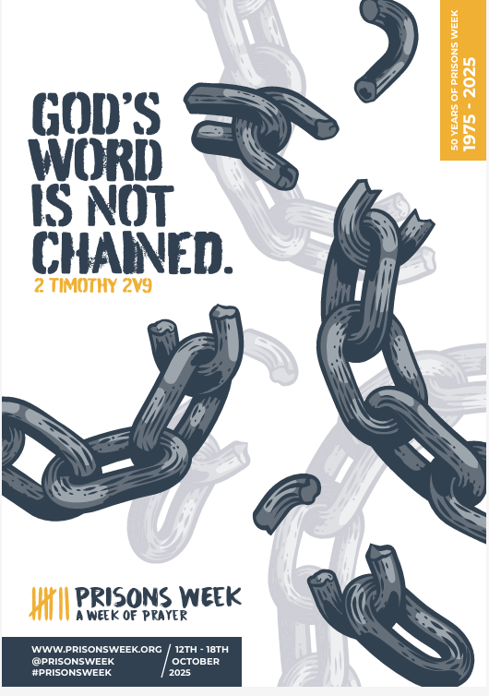
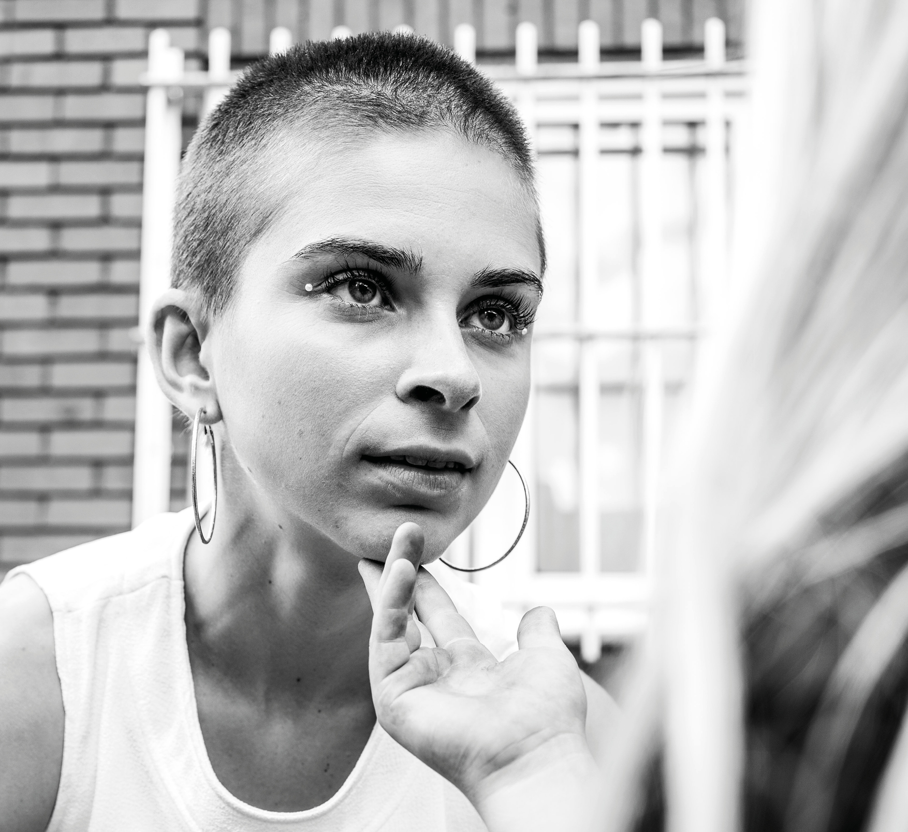

Prisons Week
BDES
BDES

Slide 4
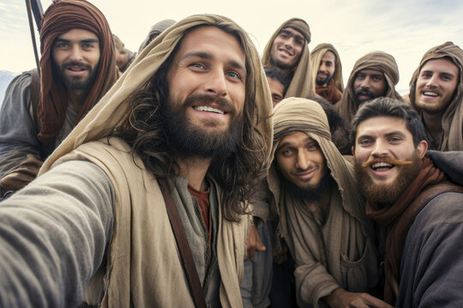
In Sunday’s Gospel Reading …
28th Sunday in Ordinary Time 5th October 2025
In the Gospel of Luke,
Jesus’ friends ask him :
“Increase our faith.”
BDES

Slide 5

Preparing for World Youth Day 2027
“Friendship
in Christ
is our guiding star.”
- Pope Leo,
August 2025
BDES

Slide 6
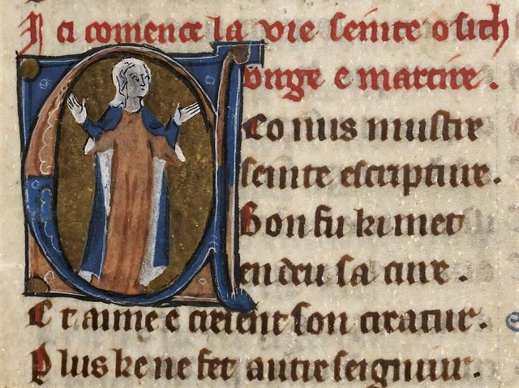
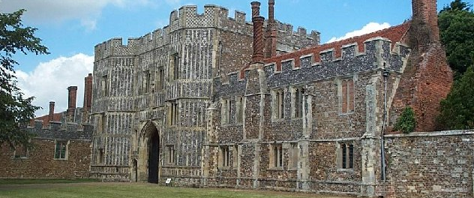
St Osyth : 7th October
St Osyth or Osgyth was an English saint of the 8th century from the Kingdom of Essex. She was from a noble family and became the abbess of a priory near the manor Chich. She probably died about 700 AD, martyred by beheading by some raiding pirates for refusing to renounce her faith.
In the 12th Century a priory of Augustinian Canons was built on the site of Osyth’s monastery and named after her. The village of Chich also took on her name. It was later dissolved during the Dissolution of the Monasteries by Henry VIII. The buildings were sold to the Darcy family in the 16th century and part of the gatehouse remains visible today.
BDES

Slide 7
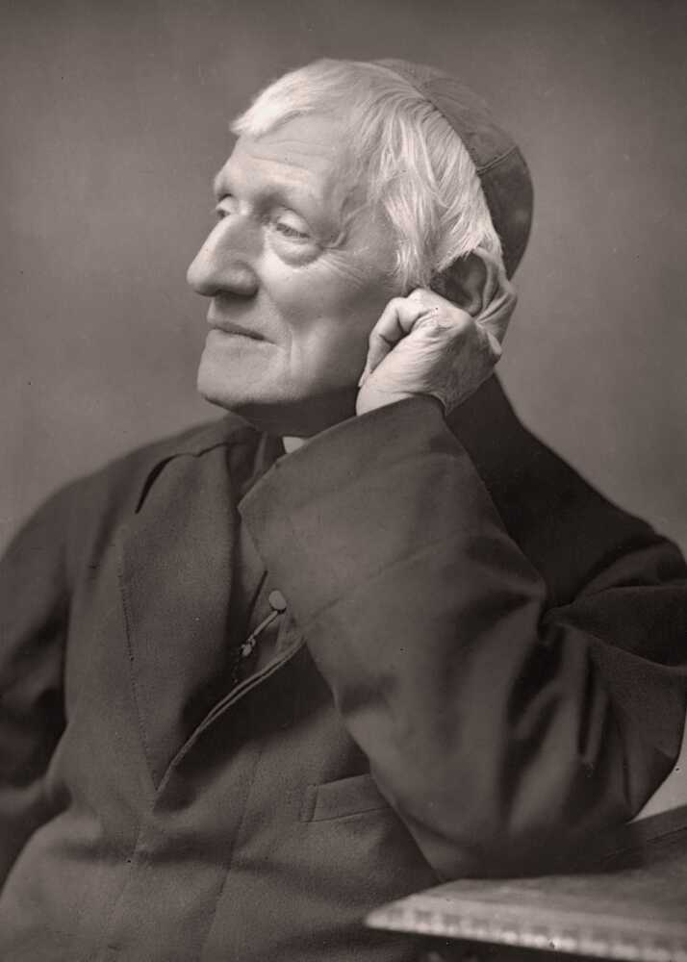
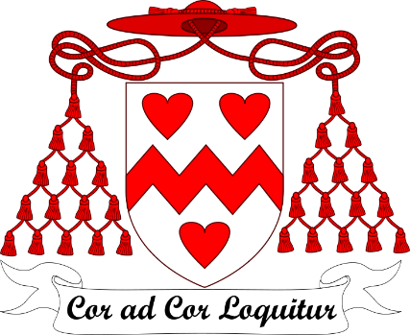
St John Henry Newman: 9th October
St John Henry Newman chose “Heart speaks unto Heart” as the motto to go on his coat of arms when he became a Cardinal in 1879. Inspired by these words spoken by St. Francis de Sales, Newman calls us to hear God speaking to our hearts and to listen for our mission from God.
BDES

Slide 8
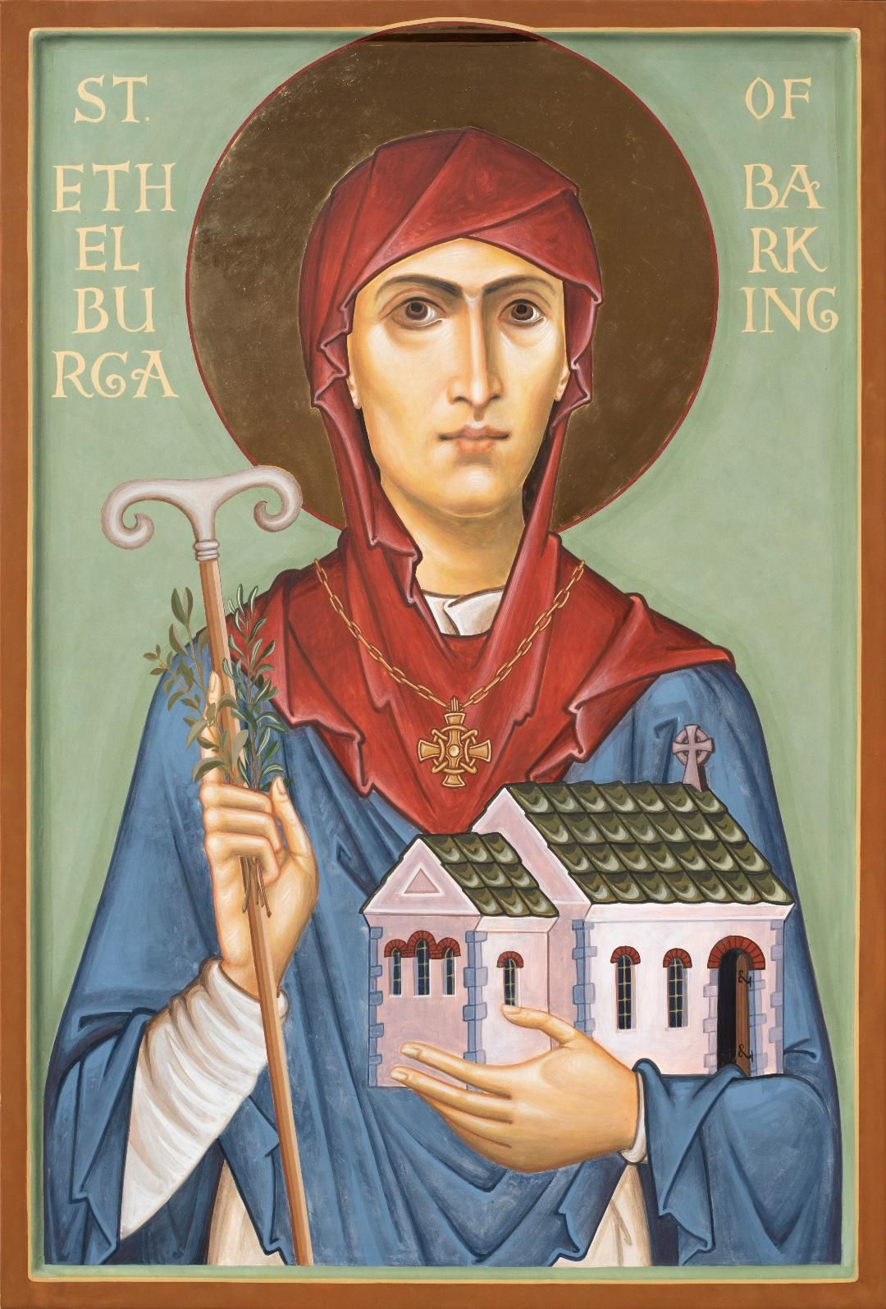
St. Ethelburga of Barking
11th October
A local saint of our diocese, St Ethelburga (Aethelburh) was the sister of St Erconwald, a 7th-century bishop of London, and abbess of a monastery for both men and women in Barking. The Anglo-Saxon historian Saint Bede describes her as “upright in life and constantly planning for the needs of her community.”
BDES

Slide 9
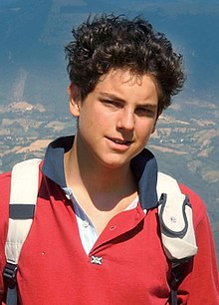
St Carlo Acutis : 12th October
Carlo Acutis died of leukaemia in 2006, aged only 15.
He was born in 1991 in England of Italian parents and moved to Italy when he was small.
At home he would spend time with friends whose parents were going through a divorce and in school he stood up for people who were being bullied. He volunteered to work with the homeless but was also an amateur computer programmer who enjoyed films and playing on his PlayStation.
He spent time documenting Eucharistic miracles from around the world on his website.
Following a miracle attributed to him he was beatified in 2020 by Pope Francis, and was canonised – declared a saint – on 7th September 2025.
BDES

Slide 10

YOUCAT WEEKLY SELECTION
#120 WHAT DOES THE HOLY SPIRIT DO IN MY LIFE?
The Holy Spirit makes me receptive to God; he teaches me to pray and helps me to be there for others. Augustine calls the Holy Spirit “The quiet guest of our soul”. Anyone who wants to sense his presence must be quiet. Often this Guest speaks very softly within us and with us, for instance, in the voice of our conscience or through other interior and exterior promptings.
BDES

Slide 11
Walking the Path
~ Walking the Path of Hope ~
Monday 6th October 2025
Brentwood Diocese Education Service

