Slide 1
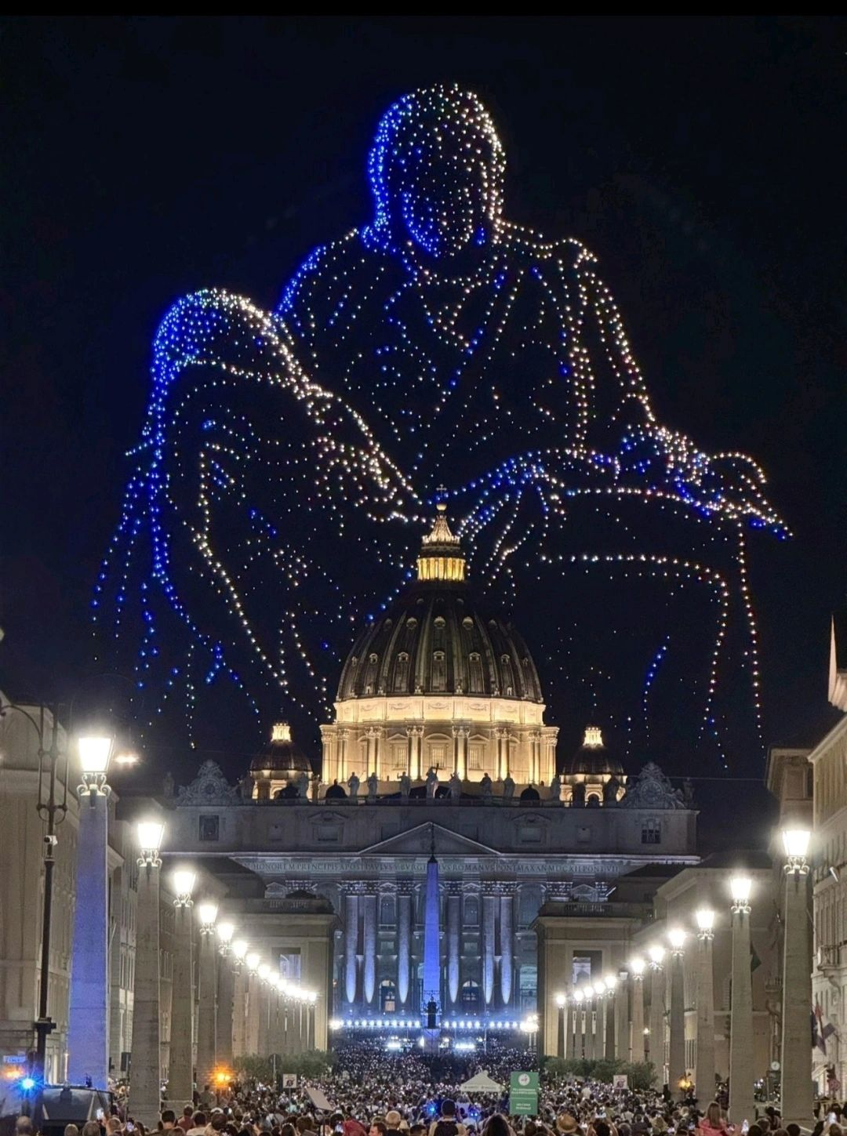
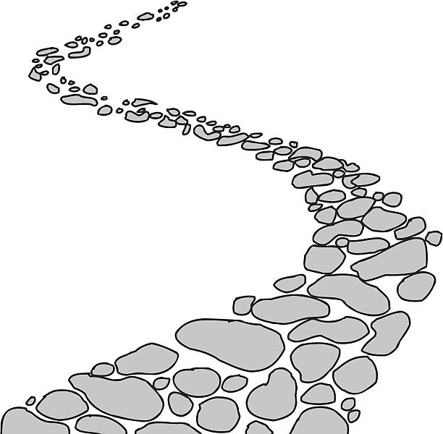

Walking the Path
~ Walking the Path of Hope ~
Monday 13th October 2025
Brentwood Diocese Education Service

Slide 2
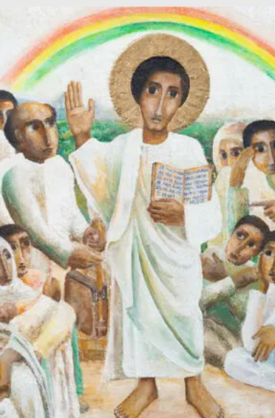
Reflection
Today we focus on the halo given to Jesus to signify his divinity. It is a technique used in art work in many cultures, styles and times.
It was not possible to obtain gold leaf in Ethiopia because of the fragile state of the area in which the artist lives. Paint was used instead. The challenge of painting an icon in such turbulent times inspires us to reflect again on the Jubilee message.
BDES

Slide 3
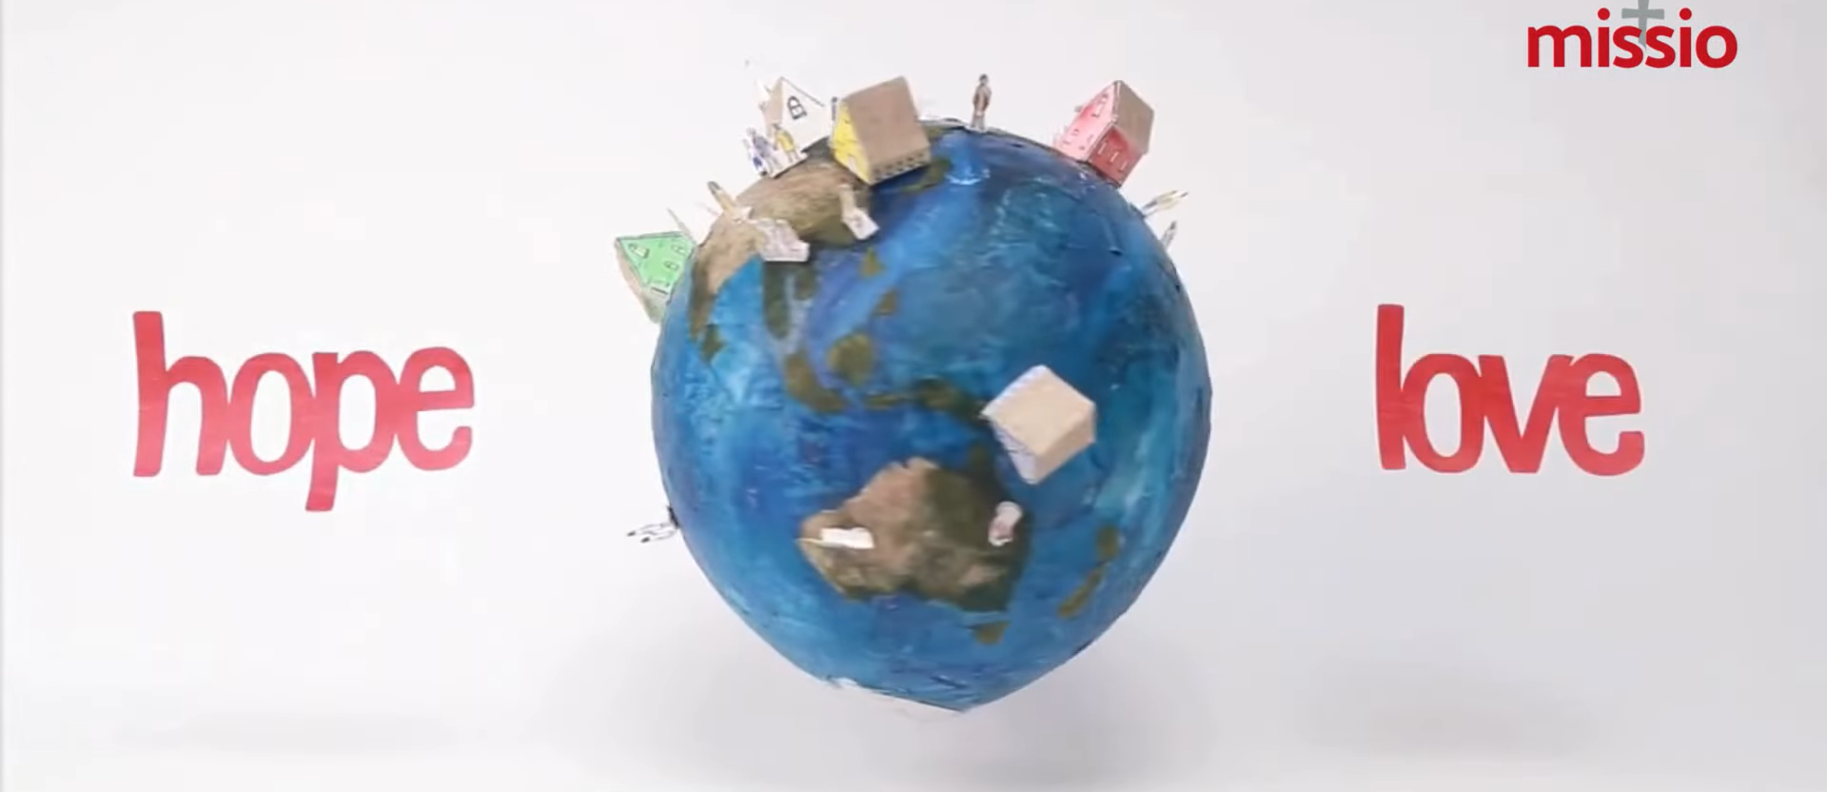
World Mission Sunday

Slide 4
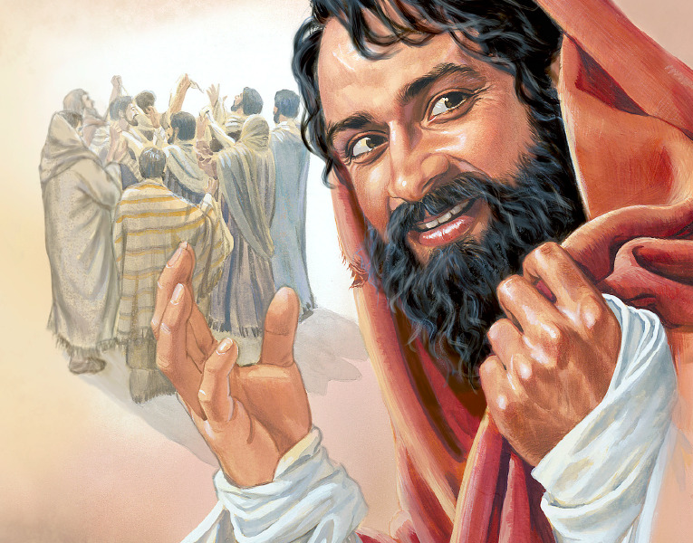
In Sunday’s Gospel Reading …
28th Sunday in Ordinary Time
12th October
“Your faith
has made you well.”
BDES

Slide 5
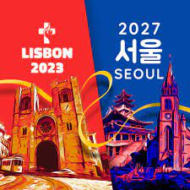
Preparing for World Youth Day 2027
“Dear young people,
love one another!”
Pope Leo, August 2025,
Message to Young People at the Jubilee of Youth
BDES

Slide 6
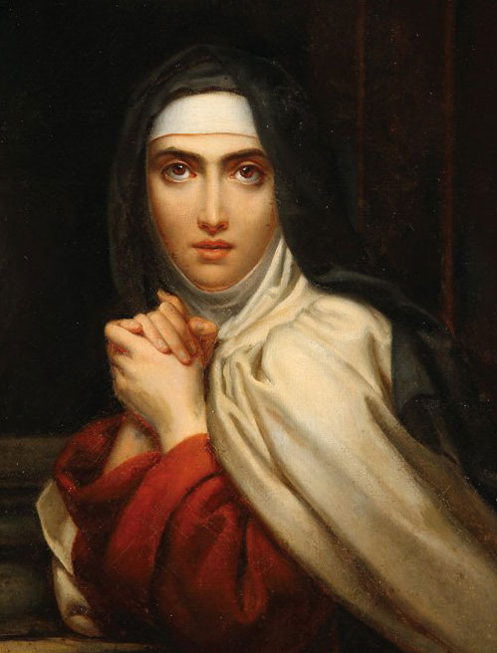
St Teresa of Ávila:
15th October
St Teresa founded the order of Discalced Carmelites. She was a mystic, a religious reformer, an author, a theologian of the contemplative life and prayer, and has been such an influential thinker that she has been declared a Doctor of the Church. Her famous prayer is a source of comfort and calm :
Let nothing disturb you. Let nothing frighten you. All things pass away. God never changes. Patience obtains all things.
Whoever has God lacks nothing. God alone suffices.
BDES

Slide 7
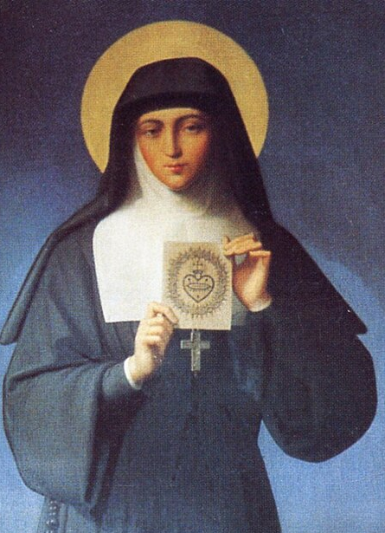
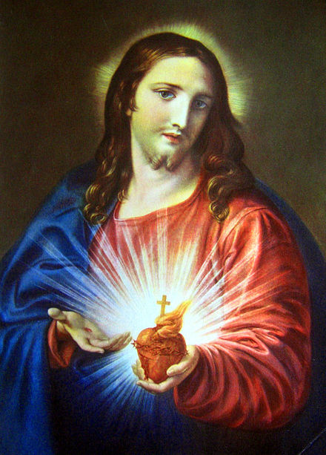
St Margaret Mary Alacoque: 17th October
.
Margaret Mary Alacoque, VHM was born on 22nd July 1647 and died on 17th October 1690. She was a French nun in the Visitation order. She had been ill as a child and during this time offered to become a religious. As she grew older her family wanted her to marry but she was visited by a vision of Christ and became a nun at the age of 24.
In the convent she saw a number of visions of Christ and as a result she promoted devotion to the Sacred Heart of Jesus in its modern form.
BDES

Slide 8
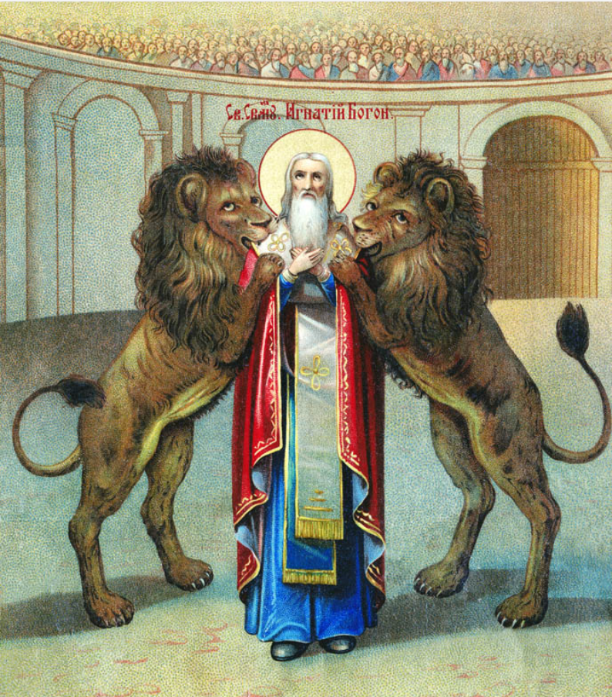
St Ignatius of Antioch
17th October
Ignatius was the third Bishop of Antioch after St Peter and Evodius. For this role he was arrested, condemned to death and sent to Rome to be thrown into the arena with the wild beast. This is why he is so often pictured in this way.
He was a powerful letter-writer in which he would support Christians with their challenges in Christian living, give advice on Church structure, and talk at length about Christian theology. The Church awes a lot of its understanding of early Church history to St. Ignatius.
BDES

Slide 9
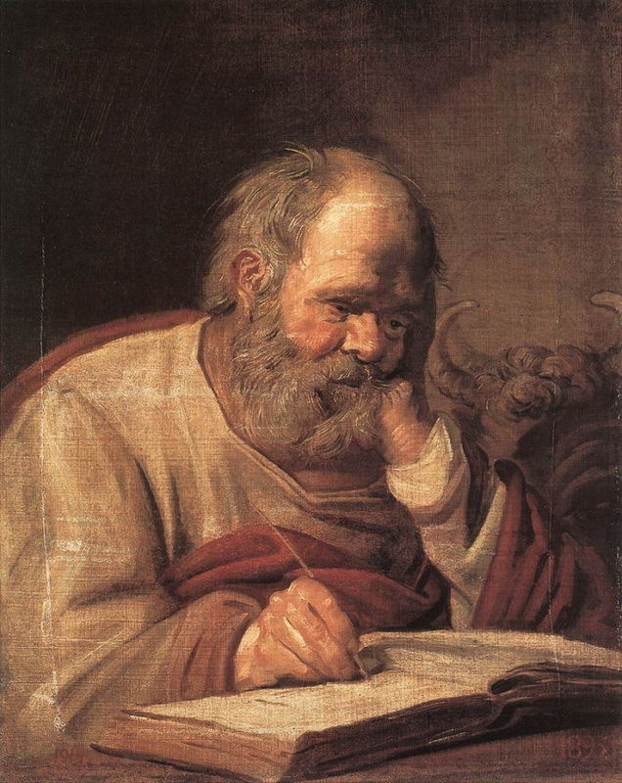
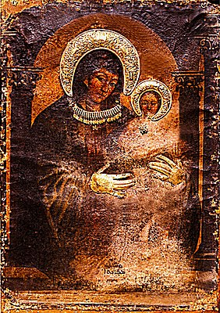
St Luke : 18th October
One of the four Evangelists, the Gospel writers, Saint Luke was a follower of St Paul and by tradition a physician.
He is thought to have written both the Gospel that bears his name and the Acts of the Apostles, found in the New Testament.
As well as being the patron saint of doctors he is also the patron saint of artists as according to an ancient story he was the painter of an icon of xxx the Madonna and Christ Child.
BDES

Slide 10

YOUCAT WEEKLY SELECTION
# 512 : HOW DID THE ‘OUR FATHER’
COME ABOUT?
The Our Father came about at the request of one of Jesus’ disciples, who saw his Master praying and wanted to learn from Jesus himself how to pray correctly.
It is a beautiful reminder about setting ourselves up in the correct way to make space for prayer in our lives both physically and spiritually.
The answer that Jesus gives, as recorded in Matthew 6 : 9-13, forms the prayer as we know it today.
BDES

Slide 11
Walking the Path
~ Walking the Path of Hope ~
Monday 13th October 2025
Brentwood Diocese Education Service

