Slide 1
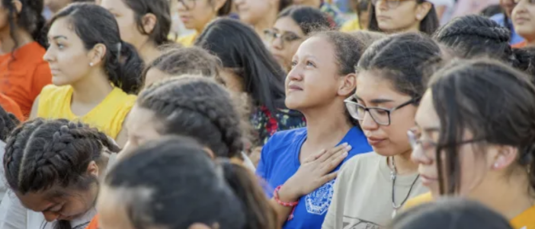


Walking the Path
~ Walking the Path of Hope ~
Monday 20th October 2025
Brentwood Diocese Education Service

Slide 2
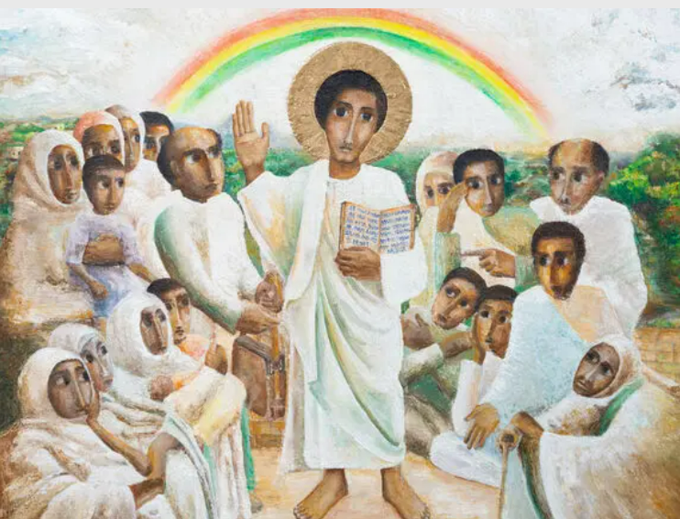
Reflection
Look at Jesus in the centre of the crowd.
Jesus’ right hand is raised to show that He is teaching.
People at the time often addressed Him as “Rabbi” : teacher.
- CAFOD Jubilee 2025 : Exploring the Jubilee Icon
BDES

Slide 3
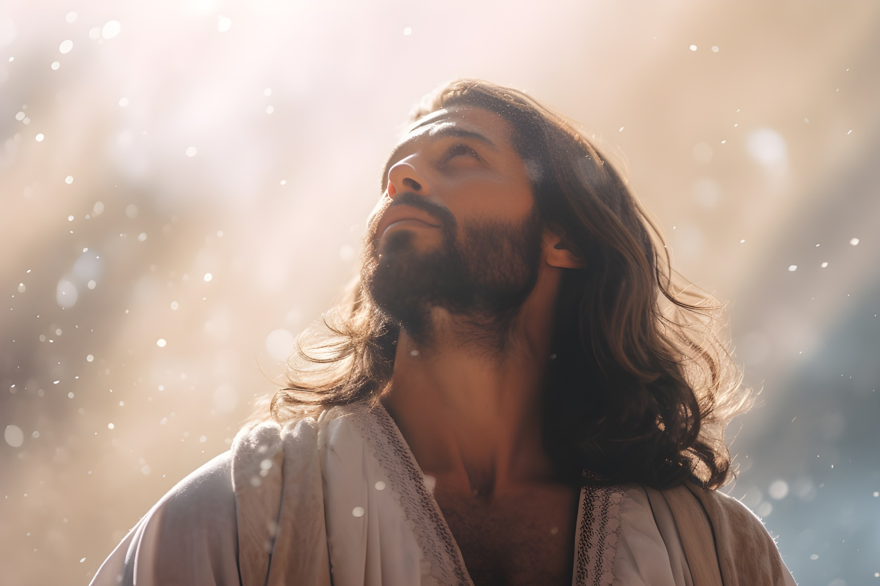
In Sunday’s Gospel Reading …
30th Sunday in Ordinary Time 19th October 2025
In the Gospel of Luke,
Jesus tells us that
“He will see that they get justice.”
BDES

Slide 4

Preparing for World Youth Day 2027
“Love
one another in Christ.”
- Pope Leo,
August 2025
BDES

Slide 5
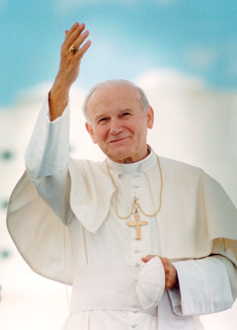
Saint Pope John Paul II : 22nd October
Pope John Paul II was born in Poland as Karol Wojtyla before World War II.
He was a good sportsman, often playing in goal in football and was also involved in the theatre in his younger days.
He was an impressive linguist, using nine of the languages he had learnt when he became Pope.
His decision to become a priest came during the war; he survived having hidden from the German forces who rounded up many of the young men in Krakow.
He was made a Bishop in 1958 and was involved in the Second Vatican Council and in 1964 was made Archbishop of Krakow. In 1978 (the year of the three Popes) he was elected by the College of Cardinals and took the name John Paul II.
He pioneered World Youth Day and was very active in all areas of the Papacy.
He died in 2005 following a period of ill health.
He was beatified by his successor Pope Benedict in 2011 and canonised by
Pope Francis with Emeritus Pope Benedict concelebrating in 2014.
BDES

Slide 6

YOUCAT WEEKLY SELECTION
#60 WHY IS JESUS THE GREATEST EXAMPLE IN THE WORLD?
Jesus was more than an ideal man. Even seemingly ideal men are sinners. That is why no human can be the measure of humanity. Jesus, however, was without sin. We cannot know what it means to be a human, and what makes humans infinitely lovable
except in Jesus Christ, who
“in every respect has been tempted as we are,
yet without sinning” (Heb 4:15).
Jesus , the Son of God, is the authentic, true man.
In Him we recognize how God willed man to be.
BDES

Slide 7
Walking the Path
~ Walking the Path of Hope ~
Monday 20th October 2025
Brentwood Diocese Education Service

