Slide 1
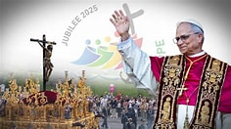


Walking the Path
~ Walking the Path of Hope ~
Monday 17th November 2025
Brentwood Diocese Education Service

Slide 2
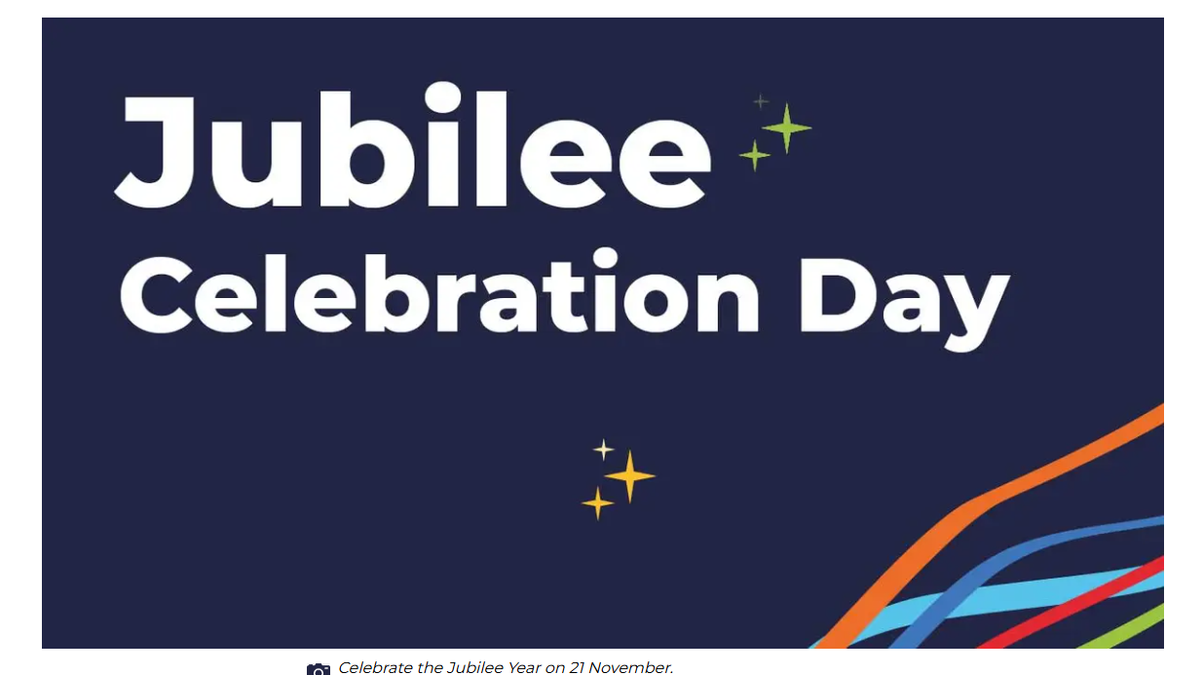
Reflection
BDES

Slide 3

In Sunday’s Gospel Reading …
Sunday 16th November
“Stand firm, and you will win life.”
BDES

Slide 4

Preparing for World Youth Day 2027
“Friendship is a path to peace.”
Pope Leo, August 2025,
Message to Young People at the Jubilee of Youth
BDES

Slide 5
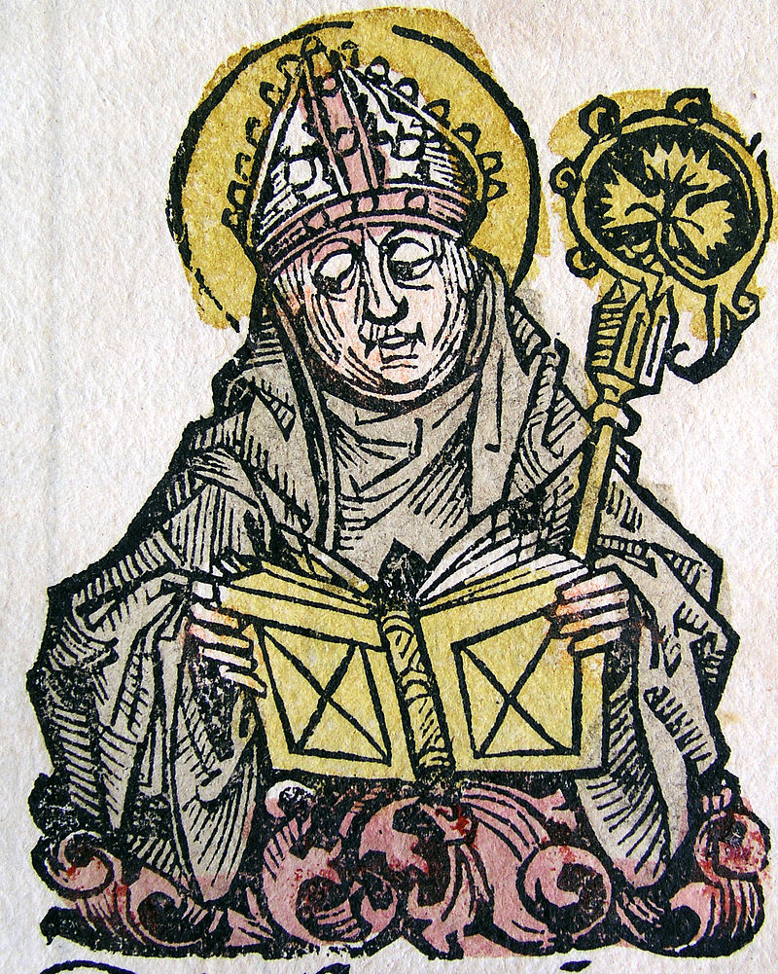
St. Edmund of Canterbury:
16th November
St Edmund, along with Our Lady of Lourdes, St Erconwald and St Cedd, is one of the patrons of the Diocese of Brentwood. He was a renowned scholar of the universities of Paris and Oxford and was appointed as Archbishop of Canterbury in 1233. St Edmund’s Hall, one
of the colleges of the University of Oxford, is named after him.
BDES

Slide 6
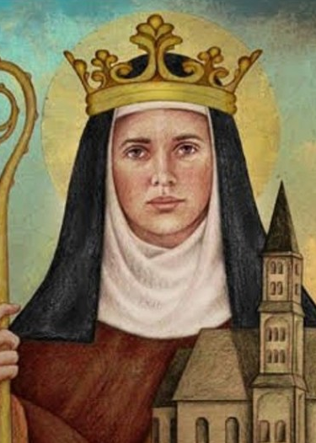
St Hilda of Whitby:
17th November
St Hilda (c. 614 – 680 AD) was the founding abbess of the double monastery (i.e. a monastery for men and women) at Whitby in Yorkshire. She was so highly respected that her monastery was chosen as the venue for the important Synod of Whitby in the year 664, where the Christians of Northumbria agreed to accept the dating of Easter according to the Church of Rome. The historian St Bede wrote of her : “All who knew her called her mother because of her xxxxx outstanding devotion and grace.”
BDES

Slide 7
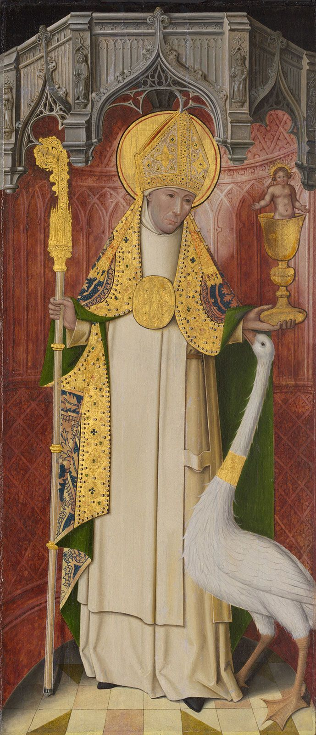
St Hugh of Lincoln: 17th November
Like most of the great churchmen who came to England from abroad in the Middle Ages, Hugh of Avalon in Burgundy was a mighty builder. He rebuilt Lincoln cathedral, ruined by the great earthquake of 1185 and is responsible for the four bays of the choir, one of the finest examples of the Early English pointed style. He also began the great hall of the bishop’s palace. St. Hugh’s emblem is a white swan, in reference to the beautiful story of the swan of Stowe which contracted a deep and lasting friendship for the saint, even guarding him while he slept.
BDES

Slide 8
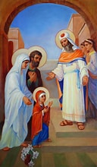
Presentation of the Blessed Virgin Mary
21st November
In unity with Eastern Christianity, this feast celebrates Mary's 'dedication' of herself to God from her infancy, inspired by the Holy Spirit, whose grace had filled her ever since her immaculate conception.
BDES

Slide 9
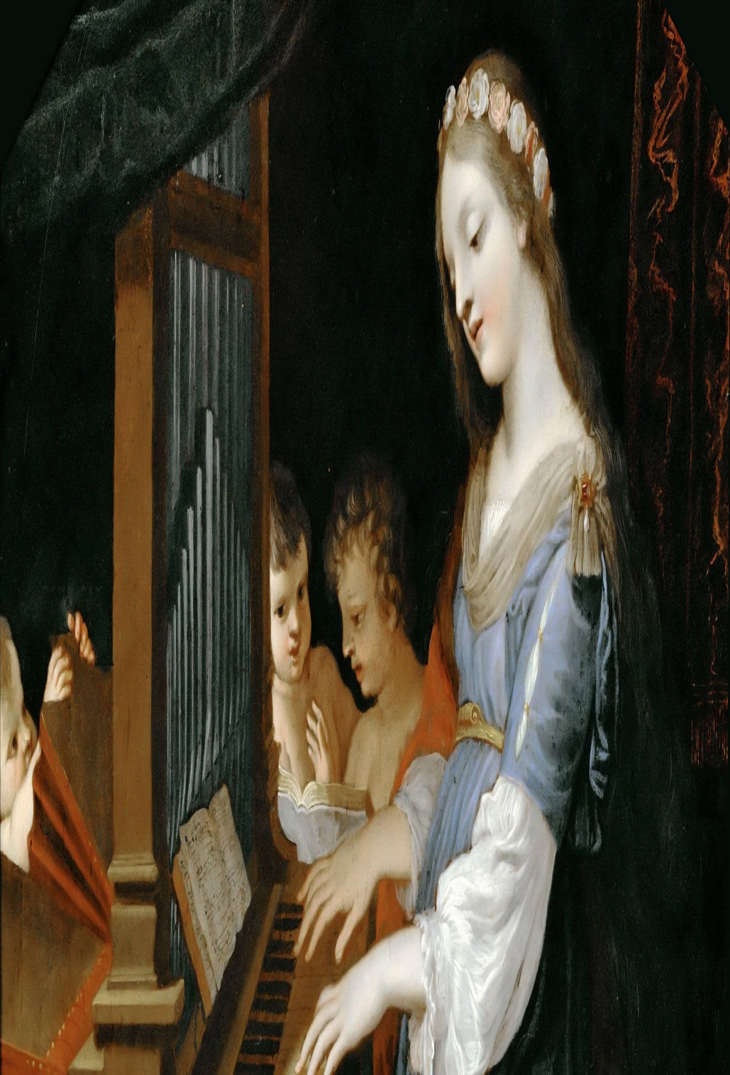
St. Cecilia:
22nd November
St Cecilia is the patron saint of musicians with her feast day often being celebrated with concerts and musical events. She symbolizes the central role of music in the Liturgy of the Church.
She lived in Roman times and was executed for her beliefs. At her wedding, she was reputed to have sung her heart to God and was responsible for the conversion of her husband, who was baptized by Pope Urban I. She did good works and distributed her goods to the poor.
Her death followed that of her husband and brother-in -law, and she requested that after her death her home be converted into a church.
BDES

Slide 10

YOUCAT WEEKLY SELECTION
#158 WHAT IS HEAVEN?
Heaven is the endless moment of love. Nothing more separates us from God, whom our soul loves and has sought our whole life long. Together with all the angels and saints we will be able to rejoice forever in and with God.
BDES

Slide 11
Walking the Path
~ Walking the Path of Hope ~
Monday 17th November 2025
Brentwood Diocese Education Service

