Slide 1
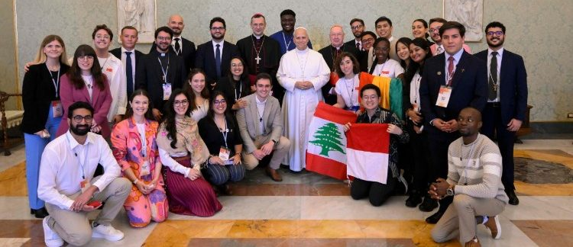
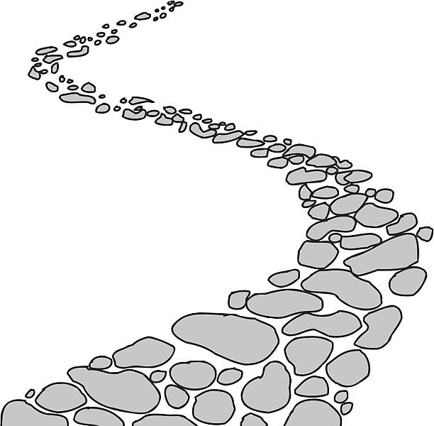

Walking the Path
~ Walking the Path of Hope ~
Monday 24th November 2025
Brentwood Diocese Education Service

Slide 2

Reflection
THE JUBILEE LOGO
As we approach the end of the
Jubilee of Hope, we will turn our attention
to the logo that has accompanied us on our
journey this year.
Each week, a different part of the logo
will be explained.
BDES

Slide 3






What do you notice?
Reflection
Four figures, representing everyone on earth, all different kinds of people from all different places on earth.
They embrace each other to show solidarity, friendship and that we should be one united, global family.

Slide 4
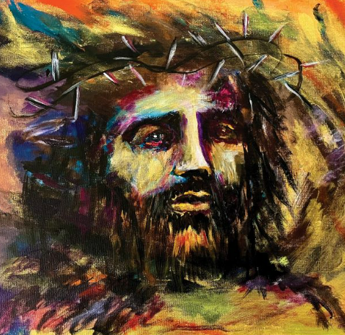
In Sunday’s Gospel Reading …
23rd November 2025
In the Gospel of Luke,
we hear the words :
“Jesus, remember me when you come into your kingdom.”
BDES

Slide 5
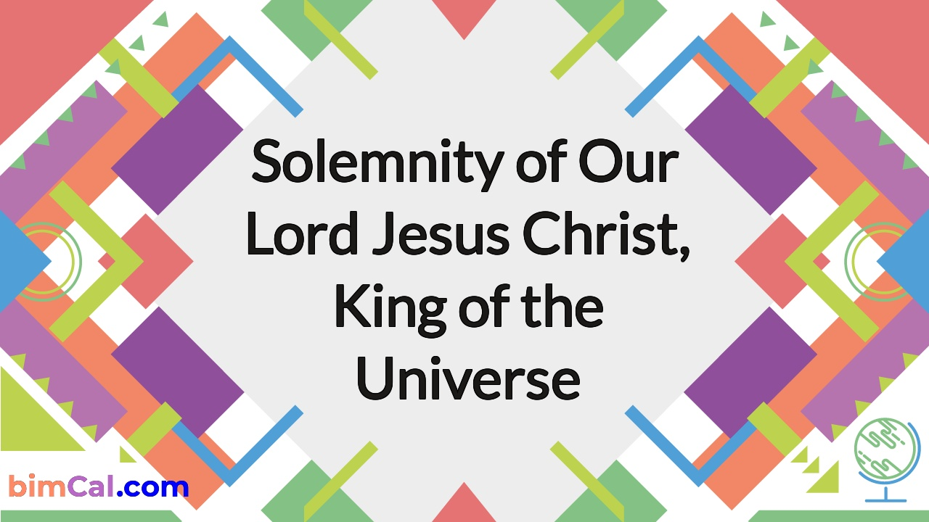
SUNDAY 23rd November 2025
BDES
BDES

Slide 6
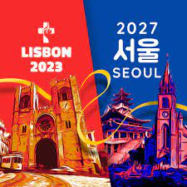
Preparing for World Youth Day 2027
“The courage to choose comes from love.”
- Pope Leo,
August 2025
BDES

Slide 7
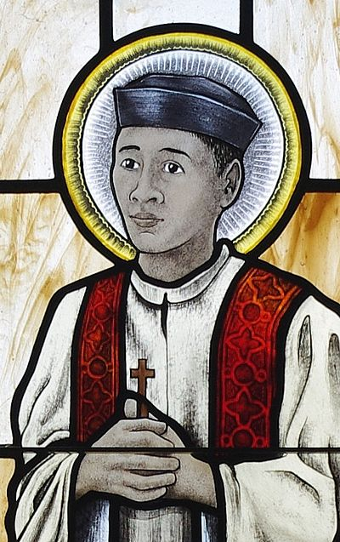
Saint Andrew Dung-Lac:
24th November
His feast day is on 24th November, a day which commemorates all the Vietnamese martyrs of the seventeenth, eighteenth and nineteenth centuries. Andrew was born in Vietnam in 1795 and became a priest in 1823. To avoid persecution he changed his name, but was still captured and executed.
He was canonised in 1988 by Pope John Paul II.
BDES

Slide 8

YOUCAT WEEKLY SELECTION
#469 WHAT IS PRAYER?
Prayer is turning the heart toward God.
When a person prays, they enter into a living relationship with God. Prayer is the great gate leading into faith. People who pray entrust themselves more and more to God. Even now they seek union with the One whom they will encounter one day face to face. Therefore, the effort to pray daily is part of Christian life. As strange as it sounds, prayer is a gift one obtains through prayer.
BDES

Slide 9
Walking the Path
~ Walking the Path of Hope ~
Monday 24th November 2025
Brentwood Diocese Education Service

