Slide 1

Governors and catholic school inspection
An Overview & Updates
Nancy Conoboy
Chief Inspector of Schools
February 2026
Brentwood Diocese Education Service

Slide 2
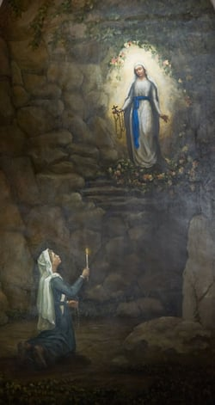
11th February 2026 Feast of Our Lady of Lourdes Opening Prayer

Slide 3
Opening Prayer
Loving God, on this Feast of Our Lady of Lourdes, we gather in gratitude for the mission you entrust to us: to serve your Church, as we uphold the dignity of Catholic education, and accompany schools in truth, charity, and hope. Give us clarity of mind, compassion of heart, and a listening spirit.

Slide 4
Help us to recognise your presence in every school community we encounter, and to support leaders, governors, teachers, and pupils with encouragement and wisdom. We ask the intercession of Our Lady, who appeared to St Bernadette with gentleness and humility. May her example guide us today. We make our prayer through Christ our Lord.
Amen.

Slide 5
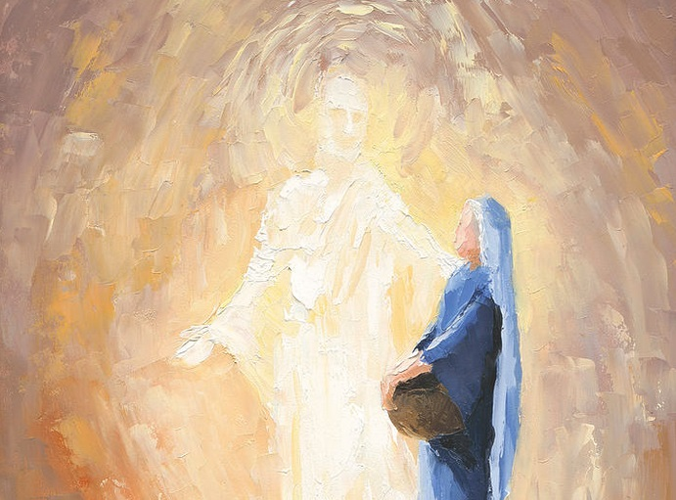
The Annunciation Luke 1:26-38
‘Behold I am the servant of the Lord: let it be to me according to your word.’
Notes:
This Reading highlights Mary’s humility, trust and obedience to God, which are central to her appearance at Lourdes. It can remind us that saying ‘yes’ to God can happen in all of our lives.

Slide 6
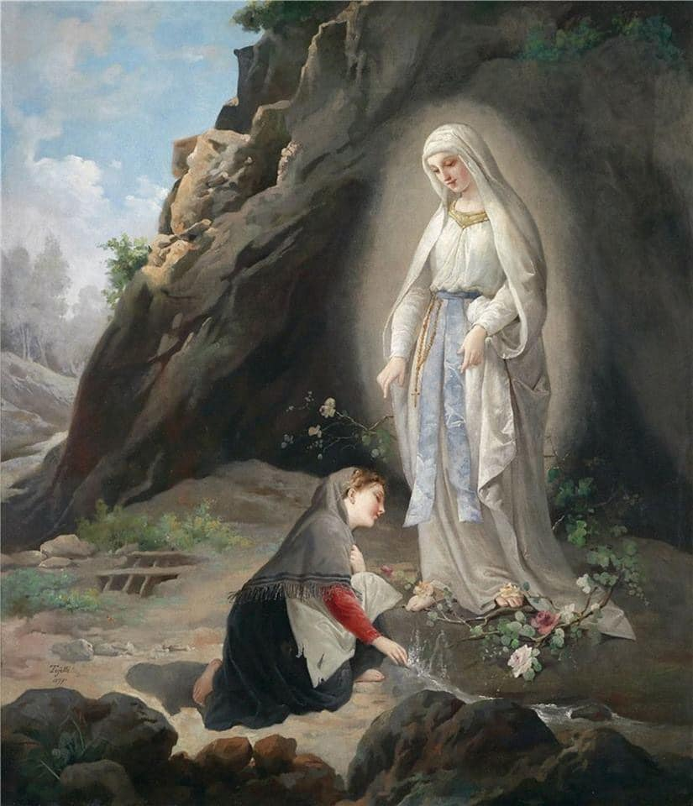
Notes:
As Catholic school inspectors, we often step into environments where learning, culture, and faith all meet— often with quiet, unseen grace at work.
In this mission, Our Lady of Lourdes offers a powerful lens through which to understand our role.
When Mary appeared to Bernadette in the quiet grotto of Massabielle, she did not appear in a place of prestige or comfort. She met a young girl in humility, simplicity, and sincerity.
Lourdes teaches us that God’s most transformative work often begins in the hidden places, where God sees possibility.
Today the Church invites us to contemplate Our Lady of Lourdes, a title rooted in Mary’s appearances in 1858.
At the heart of those encounters is a message that resonates deeply with the ministry of Catholic School Inspectors.

Slide 7
Humility and Simplicity
Notes:
Humility and Simplicity
Mary chose Bernadette, a young, poor girl with limited education. Lourdes reminds us that God often speaks through unexpected voices.
As inspectors, we are called to approach every school with humility, ready to discover the grace at work in places that may at first seem ordinary or overlooked.

Slide 8
Healing and Restoration
Notes:
Healing and Restoration
Lourdes is a place of physical, emotional, and spiritual healing.
Inspectors are not healers in the literal sense, but our presence can bring clarity, reassurance, and renewed purpose to school communities.
Our questions, guidance, and feedback can be instruments of encouragement and growth.

Slide 9
Listening with Heart
Notes:
Listening with the Heart
Bernadette listened—carefully, quietly, reverently.
In our role, listening is equally essential:
• to leaders sharing their joys and challenges,
• to staff who serve tirelessly,
• to pupils who reveal the heart of the school through their words and behaviour.
Listening allows us to see what data cannot capture.

Slide 10
Witnessing to Hope
Notes:
Witnessing to Hope
Lourdes is a sign of hope for millions. Our work, too, can be hopeful work: affirming what is strong, recognising the movement of the Holy Spirit, and helping schools grow in confidence in their Catholic mission.

Slide 12
Together, let us ask the intercession of Our Lady as we pray, Hail Mary…
Our Lady of Lourdes, pray for us
St Bernadette, pray for us

Slide 13
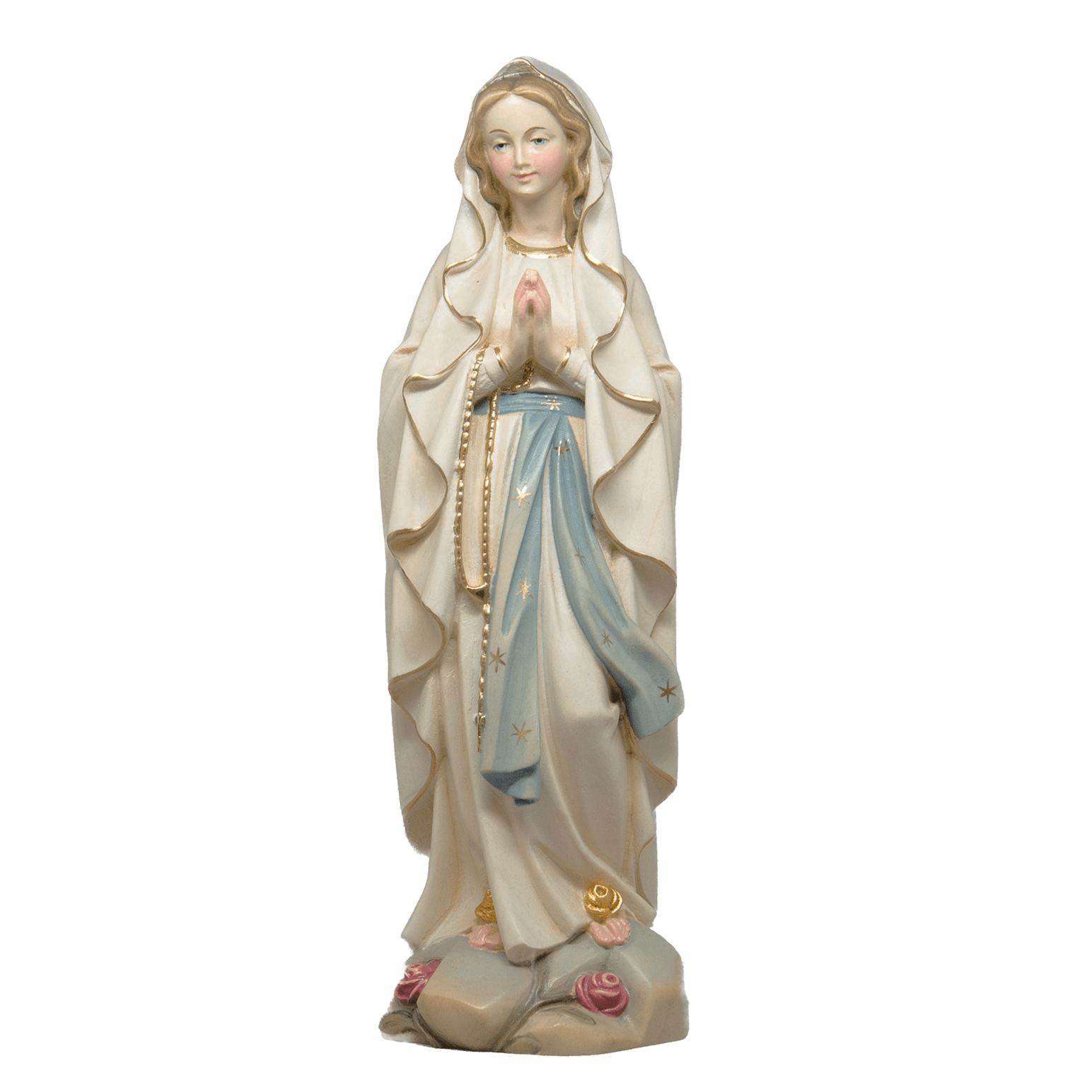

Notes:
Images of Our Lady of Lourdes, Mary is shown with two yellow (golden) roses on her bare feet because that’s how St. Bernadette Soubirous described the apparition in 1858—and the symbolism runs deep.
1. Faithful to Bernadette’s vision Bernadette repeatedly said the Lady wore a white robe, a blue sash, and yellow roses on each foot. Artists kept those details to show the image is grounded in the actual Lourdes apparitions, not artistic invention.
2. Roses = Mary herself In Catholic symbolism, Mary is often called the “Mystical Rose.” Roses represent:
purity and beauty
heavenly joy
love without thorns (sinlessness)
3. Yellow/gold = heavenly glory The roses aren’t red (suffering) but golden/yellow, symbolizing:
divine light
glory of heaven
the joy of the Resurrection

Slide 14
Hope
Healing
Grace
Notes:
This fits Lourdes’ message of hope, healing, and grace.

Slide 15

Closing Prayer
Loving God,
as we conclude our time together,
we thank You for the wisdom, insight, and collaboration shared today.
Guide us as we continue in our mission of supporting our schools
so they may be places where faith, learning, and love can flourish.

Slide 16
Lord Jesus,
give us eyes to see each community with fairness and hope,
ears to listen with patience and understanding,
and hearts rooted in compassion for all entrusted to our care.

Slide 17
Holy Spirit,
fill us with courage, clarity, and gentleness
so that our work may always reflect the Gospel
and help each school grow in truth and integrity.
Mary, Our Lady of Lourdes,
intercede for us as we accompany our schools.
May your humility, tenderness, and trust in God
inspire the way we serve, support, and lead.

Slide 18
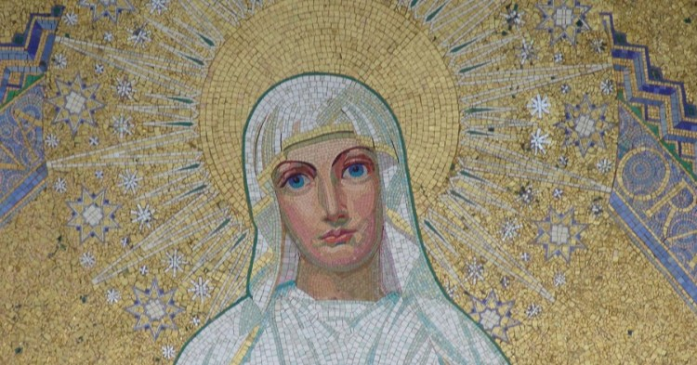
We ask that You bless the pupils, staff, and leaders
of every school in our diocese,
and grant us safe travel, renewed strength,
and a joyful spirit for the work ahead.
We make this prayer through Christ our Lord.
Amen.

Slide 19
The Synoptic Problem
Aims of the Session
To give an overview of the CSI Framework & process for governors
To provide the latest updates on CSI
To explore what the data is telling us
To provide an opportunity for Q&A
BDES

Slide 20
The Synoptic Problem
Guardians of the mission
All Catholic schools have a dual responsibility to both Church and State because they must be aware and accountable not only to the law of the land but also to requirements of the 1983 Code of Canon Law.
Pope Benedict XVI, The Big Assembly, St Mary's University (2010)
BDES

Slide 21
The Synoptic Problem
Guardians of the mission
In your Catholic schools, there is always bigger picture over and above the individual subjects you study, the different skills you learn. All the work you do is placed in the context of growing in friendship with God, and all that flows from the friendship.
Pope Benedict XVI, The Big Assembly, St Mary's University (2010)
BDES

Slide 22
The Synoptic Problem
Guardians of the mission
Governors are the 'big picture' people who, with the Headteacher, set the next strategic steps for the journey.
How to Survive as a Governor in a Catholic School, Russi, J. (2015)
BDES

Slide 23
The Synoptic Problem
Guardians of the mission
The greatest need many have today is being able to articulate what it is they are actually there to guard, promote and protect.
How to Survive as a Governor in a Catholic School, Russi, J. (2015)
BDES

Slide 24


Your Experience
Budget
Timetable
Staffing
Senior Leaders
CPD schedule
Curriculum
MISSION STATEMENT
Notes:
We must be careful not to allow the How to dominate our thinking
We must be careful not to compartmentalise and think that the why is only about RE, or Mass, or assemblies.
The WHY must underpin everything we do, it must be our starting point, reference point, and our ultimate goal
If you show me your budget, I will show you your mission statement
If you show me your timetable I will show you your mission statement
If you show me your staffing list I will show you your mission statement
If you show me your CPD timetable I will show you your mission statement
If you show me your SLT, I will show you your mission statement

Slide 25
The Synoptic Problem
Basis of Catholic School Inspection
All Catholic schools, academies and colleges are subject to canonical inspection by their diocesan bishop. Some schools and academies are subject to a Section 48… inspection (or their academy equivalents) and for those schools the canonical inspection fulfils this statutory function.
Section 5 … inspectors must not inspect religious education or the content of collective worship. This is the legal prerogative of the Catholic Bishop.
A protocol defining the relationship between the diocesan inspectorates and
Ofsted has been agreed by Ofsted and the Catholic Education Service
BDES

Slide 26
The Synoptic Problem
Basis of Catholic School Inspection
An inspection under the National Framework makes judgements on the Catholic life and mission of the school, religious education, and collective worship.
Inspectors should be sensitive to the fact that they are involved in the only individual subject inspection in the school, but it is more than this - the Catholic life and Prayer life of the school.
Governors and staff need to understand this too.
BDES

Slide 27
The Synoptic Problem
Basis of Catholic School Inspection
Under Canon law, only the bishop can consent to a school calling itself Catholic
So, the purpose of inspection is:
To report to and advise the bishop on the quality of the religious education, collective worship and Catholic Life of our schools.
To inform parents and the wider Catholic community on the quality of our schools as Catholic schools/colleges.
To support, challenge, evaluate and promote the work of our schools and colleges.
BDES

Slide 28
CSI Framework content
Catholic Life and Mission | Religious Education | Collective Worship (Prayer and Liturgy)
OUTCOMES | OUTCOMES | OUTCOMES
PROVISION | PROVISION | PROVISION
LEADERS AND GOVERNORS | LEADERS AND GOVERNORS | LEADERS AND GOVERNORS
BDES

Slide 29
Catholic Life & Mission
Pupil outcomes: the extent to which pupils contribute to and benefit from the Catholic life and mission of the school​
Provision: the quality of provision for the Catholic life and mission of the school​
Leadership: how well leaders and governors promote, monitor and evaluate the provision for the Catholic life and mission of the School
BDES

Slide 30
Religious Education
Pupil outcomes: how well pupils achieve and enjoy their learning in Religious Education​
Provision: the quality of teaching, learning and assessment in Religious Education​
Leadership: how well leaders and governors promote, monitor and evaluate the provision for Religious Education
BDES

Slide 31
Collective Worship
Pupil outcomes: how well pupils participate in and respond to the schools’ collective worship
Provision: the quality of collective worship provided by the school
Leadership: how well leaders and governors promote, monitor and evaluate the provision for collective worship
BDES

Slide 32
Compliance
In addition, inspectors will judge whether a school is compliant in the following two respects:
Has it complied with the general norms for religious education laid down by the Catholic Bishops’ Conference of England and Wales and any additional requirements of the diocesan bishop?
Has it responded to the Areas for Improvement identified in the previous Catholic school inspection (or equivalent predecessor inspection)?
BDES

Slide 33
Compliance
* Meeting of targets from previous S48 inspection will be a condition of a school being judged as Outstanding or Good in terms of overall effectiveness
* Schools not having met targets from previous S48 inspection, although judged Outstanding or Good in all other areas including Compliance, will be judged in terms of overall effectiveness as Requires Improvement
BDES

Slide 34
Compliance
Principles of compliance
For age 4 -16
The Bishops require that Catholic school leaders ensure that:
Religious Education be taught for a specified portion of each repeating cycle of the regular school timetable in each year of compulsory schooling;
the amount of time must constitute at least 10% of this repeating cycle.
For age 16-19
The Bishops require that Catholic school leaders ensure that:
Religious Education be taught for a specified portion of each repeating cycle of
the regular school timetable in each year of sixth form; the amount of time must
constitute 5% of this repeating cycle.
BDES

Slide 35
Compliance
* Bishops’ Memorandum regarding reserved posts and secondary teachers of Religious Education * Directives of the Bishop – for example the use of the Come and See programme and appropriate GCSE courses
BDES

Slide 36
The Synoptic Problem
Preparation
All documentation that schools need for the inspection, including the latest version of the handbook with the appendices for different contexts, the CSED, parents and staff questionnaires and the post inspection survey can be found at
https://www.catholiceducation.org.uk/catholic-schools-inspectorate/schools
There is also a useful ‘Comparative Grade Descriptor’ document.
BDES

Slide 37
The Synoptic Problem
Process
For most schools, inspections will be 2 days long
For most primary schools there will be 2 inspectors
For most secondary schools there will be 3 inspectors
‘Tariff’’ for number of inspectors according to school size
BDES

Slide 38
The Synoptic Problem
Process
The notification period is 2 school days including the day of the call
Telephone call on Monday = Inspection on Wednesday &Thursday
Telephone call on Tuesday= Inspection on Thursday and Friday
Notification call will come from the Nancy Conoboy
BDES

Slide 39
The Synoptic Problem
Process
The lead inspector will telephone the headteacher as early as possible and always by midday on the day of notification of the inspection. This call is important… to establish a professional relationship.
The purpose of the call is to:
-make arrangements for the inspection
-inform the headteacher of the participation of any team inspector(s),
and any inspectors who are shadowing
-remind the headteacher that the chair of governors or chair of directors has a legal responsibility to inform the parents and carers about the inspection (proformas)
BDES

Slide 40
What are Inspectors Doing Before the Inspection?
Using as much available evidence as they can to develop an initial picture of the school, inspectors should access:
• information available on the school’s website
• the school’s social media platforms
• the previous Catholic Schools Inspectorate report (or predecessor
equivalent)
• for religious order schools, information pertaining to the charism of the school
• the report from the most recent statutory inspection
BDES

Slide 41
The Synoptic Problem
CSED (Catholic Self- Evaluation Document)
CSED refers to whichever document/s the school uses to record its self-evaluation of the three key judgement areas:
Catholic life and mission, religious education, and collective worship.
From three different perspectives:
a) Pupil outcome
b) Provision
c) Leadership and management
BDES

Slide 42
The Synoptic Problem
CSED (Catholic Self- Evaluation Document)
The Catholic Schools Inspectorate does not require any particular format be used for this record.
However, there is a template for those who wish to use it.
CSED needs to be sent as soon as the headteacher has had the initial telephone call with the inspector
Therefore, the school’s CSED needs to be ready and available
BDES

Slide 43
The Synoptic Problem
CSED (Catholic Self- Evaluation Document)
The inspector(s) will evaluate the school’s view of itself as expressed under these headings in the school’s CSED and explore the extent to which this is compatible with any other documentary evidence. Any discrepancies should be discussed as soon as possible with the school. The opportunity to provide further evidence to support the school’s view should be given.
.
BDES

Slide 44
The Synoptic Problem
CSED (Catholic Self- Evaluation Document)
Inspectors should check the accuracy of the school’s assessment of pupils’ progress and attainment, and also the robustness and accuracy of the school’s self-evaluation. Issues for inspection will arise from inconsistencies between the school’s judgements and conclusions in the school’s CSED and the evidence provided, and also from significant matters that the school’s CSED seems to have omitted.
BDES

Slide 45
The Synoptic Problem
The CSED
The lead inspector will use the CSED as the basis for discussion with the headteacher, RE leader and governors/directors.
Final responsibility for the school’s CSED rests with governors and/or directors.
BDES

Slide 46
The Synoptic Problem
An Overall Effectiveness Grade
In giving an overall effectiveness grade Catholic school inspectors are presenting a global judgement about how effective the school is in providing Catholic education.
In arriving at this judgement, Catholic school inspectors will make judgements on the following areas:
1. CATHOLIC LIFE AND MISSION
2. RELIGIOUS EDUCATION
3. COLLECTIVE WORSHIP
BDES

Slide 47
The Synoptic Problem
Grading
 | In England
Grade 1 | Outstanding
Grade 2 | Good
Grade 3 | Requires Improvement
Grade 4 | Inadequate
BDES

Slide 48
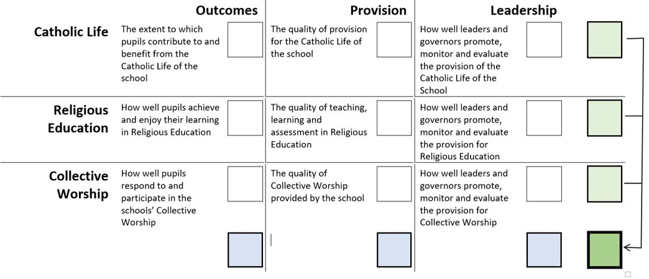

Slide 49
Overall effectiveness : Outstanding
Catholic Life and Mission | Religious Education | Collective Worship (Prayer and Liturgy)
PUPILS | PUPILS | PUPILS
PROVISION | PROVISION | PROVISION
LEADERS AND GOVERNORS | LEADERS AND GOVERNORS | LEADERS AND GOVERNORS
OUTSTANDING
OUTSTANDING
OUTSTANDING
COMPLIANT
TARGETS MET
BDES

Slide 50
Overall effectiveness : Good
Catholic Life | Religious Education | Collective Worship
PUPILS | PUPILS | PUPILS
PROVISION | PROVISION | PROVISION
LEADERS AND GOVERNORS | LEADERS AND GOVERNORS | LEADERS AND GOVERNORS
GOOD OR OUTSTANDING
GOOD OR OUTSTANDING
GOOD OR OUTSTANDING
TARGETS MET
BDES

Slide 51
Overall effectiveness : Requires Improvement #1
Catholic Life | Religious Education | Collective Worship
PUPILS | PUPILS | PUPILS
PROVISION | PROVISION | PROVISION
LEADERS AND GOVERNORS | LEADERS AND GOVERNORS | LEADERS AND GOVERNORS
GOOD OR OUTSTANDING
GOOD OR OUTSTANDING
REQUIRES IMPROVEMENT
TARGETS MET
BDES

Slide 52
Overall effectiveness : Requires Improvement # 2
Catholic Life | Religious Education | Collective Worship
PUPILS | PUPILS | PUPILS
PROVISION | PROVISION | PROVISION
LEADERS AND GOVERNORS | LEADERS AND GOVERNORS | LEADERS AND GOVERNORS
REQUIRES IMPROVEMENT
GOOD OR OUTSTANDING
GOOD OR OUTSTANDING
TARGETS MET
BDES

Slide 53
Overall effectiveness : Requires Improvement # 3
Catholic Life | Religious Education | Collective Worship
PUPILS | PUPILS | PUPILS
PROVISION | PROVISION | PROVISION
LEADERS AND GOVERNORS | LEADERS AND GOVERNORS | LEADERS AND GOVERNORS
GOOD OR OUTSTANDING
REQUIRES IMPROVEMENT
GOOD OR OUTSTANDING
TARGETS MET
BDES

Slide 54
Inspection Judgements
*The evaluation schedule is not exhaustive. Grade descriptors are not checklists and do not replace the professional judgement of inspectors- grade descriptors interpreted in relation to pupils’ age/ phase.
When making a judgment in each of the 9 judgment areas, inspectors should begin with the good descriptors.
Only if a school meets all of the requirements for good, should an inspector then consider, using the principle of best-fit, whether it meets enough of the outstanding/excellent descriptors to warrant judging the school to be outstanding in this area. If it does not meet all of the requirements for good then the inspector should use their own professional judgment, using the principle of best-fit, in deciding whether the school overall is good or requires improvement in this judgement area.
BDES

Slide 55
The Synoptic Problem
Inspections of Catholic Schools
As you are aware we have taken the decision to notify schools of their probable inspection ‘window’/academic year
Under the new framework, no inspections take place in the first two full working weeks of the autumn and spring terms or the last full working week of the summer term.
BDES

Slide 56
The Synoptic Problem
Inspections of Catholic Schools
The CSI Cycle for inspections is
5 years for schools awarded Good or Outstanding
3 years for schools judged Requires Improvement
3 years for schools judged Inadequate
From September 2021 the DfE granted a 3-year extension
BDES

Slide 57
Quality Assurance
Part of the QA process is the Post-Inspection Survey- this will be used for the monitoring and moderation of inspectors (para 79, page 26)
A nil return will be considered a positive evaluation.
There is a formal Complaints Procedure, but it is expected that issues arising should be addressed within the inspection process – for example, in the Headteacher Update Meetings with the HT.
BDES

Slide 58
The Synoptic Problem
Deferral of Inspections
We rely on up-to-date information being published and available on each school’s website when carrying out due diligence to ensure that the school will be operational on the date of the inspection.
Limited reasons for deferral – see Deferral Policy (Appendix 6.1 – Page 115)
Bereavement/serious incident: The death (within 7 days prior to notification) of a current member of staff or pupil.
• Event (Unpublished): Resulting in 75% of pupils not being on site during at least half of the inspection.
• School closure
• NB: The absence, due to illness, agreed leave or contract arrangements, of a member of the Senior Leadership Team or the Religious Education Leader or Head of Department will not be considered exceptional circumstances.
BDES

Slide 59
The Synoptic Problem
Deferral of Inspections
Only the Chief Inspector of the Diocese, in consultation with the Deputy Director/Director of Education, can defer an inspection.
BDES

Slide 60
The Synoptic Problem
… and what inspectors do?
Observe teaching and learning
Observe an act of worship -
Discuss with pupils, informally and formally
Scrutinise pupils’ work
Scrutinise the parent and staff questionnaire
Meet with the head, SLT for Catholic life, lead for RE, chaplain or priest, Head of VI Form, chair of governors, link governor for RE, CEO, a staff panel and ECTs
BDES

Slide 61
The Synoptic Problem
Now… to you!
All Governors have the responsibility to uphold the distinctive ethos of the Catholic school.
The full Governing Body is responsible for the strategic direction of the school and is actively involved in school improvement.
BDES

Slide 62
The Synoptic Problem
To be prepared for inspection
Know about RE curriculum – time and specific requirements
Know about attainment and progress in RE – overall and for specific groups of pupils
Know about the quality of teaching and about systems for monitoring RE
Know about how pupils engage with each other, how do pupils develop their sense of identity and responsibility? How do they support the most vulnerable?
Know about & attend worship – how is it evaluated?
Know about interaction with the community
Know about the CPD opportunities and the impact
BDES

Slide 63
The Synoptic Problem
Catholic Self-evaluation document (CSED)
Is your CSED evaluative?
Are your judgements supported by relevant and specific evidence?
Do you distinguish between strong and weak evidence?
Can you identify aids or barriers to improvement?
Can you identify key priorities for improvement arising from the evaluation?
BDES

Slide 64
The Synoptic Problem
To be prepared for inspection
Be part of the team writing/ reviewing the SEF or CSED
During Inspection….
Link or chair is interviewed – and present at feedback. Have a back-up!
Need to show that you know the school and are both supportive and challenging so be prepared with examples of both.
Can you identify key priorities for improvement arising from the evaluation?
BDES

Slide 65
The Synoptic Problem
Be prepared for questions on…
Strengths and areas of development in RE, Catholic life and Collective Worship
How Governors monitor the school’s performance
How Governors hold the Head to account
If the Head has a performance management target on the Catholic life
Demonstrating partnerships with the Diocese/Parish
BDES

Slide 66
The Synoptic Problem
Questions?
BDES

Slide 67
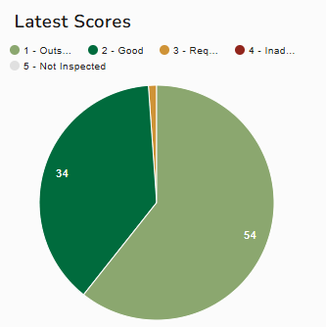
Brentwood: Overall Effectiveness As of 1/9/25
54 schools (60.7%): Outstanding
34 schools (38.2%): Good
1 school (1.1%): Requires Improvement

Slide 68
Overview of CSI inspections in Brentwood
2022 – 2023: 12 inspections (12 primary)
2 outstanding and 10 good
2023 – 2024: 17 inspections (16 primary and 1 secondary(good))
5 outstanding, 11 good and 1 requires improvement
2024 -2025 18 inspections (5 secondary (4 outstanding and 1 good) and 13 primary) 7 outstanding and 11 good.

Slide 69
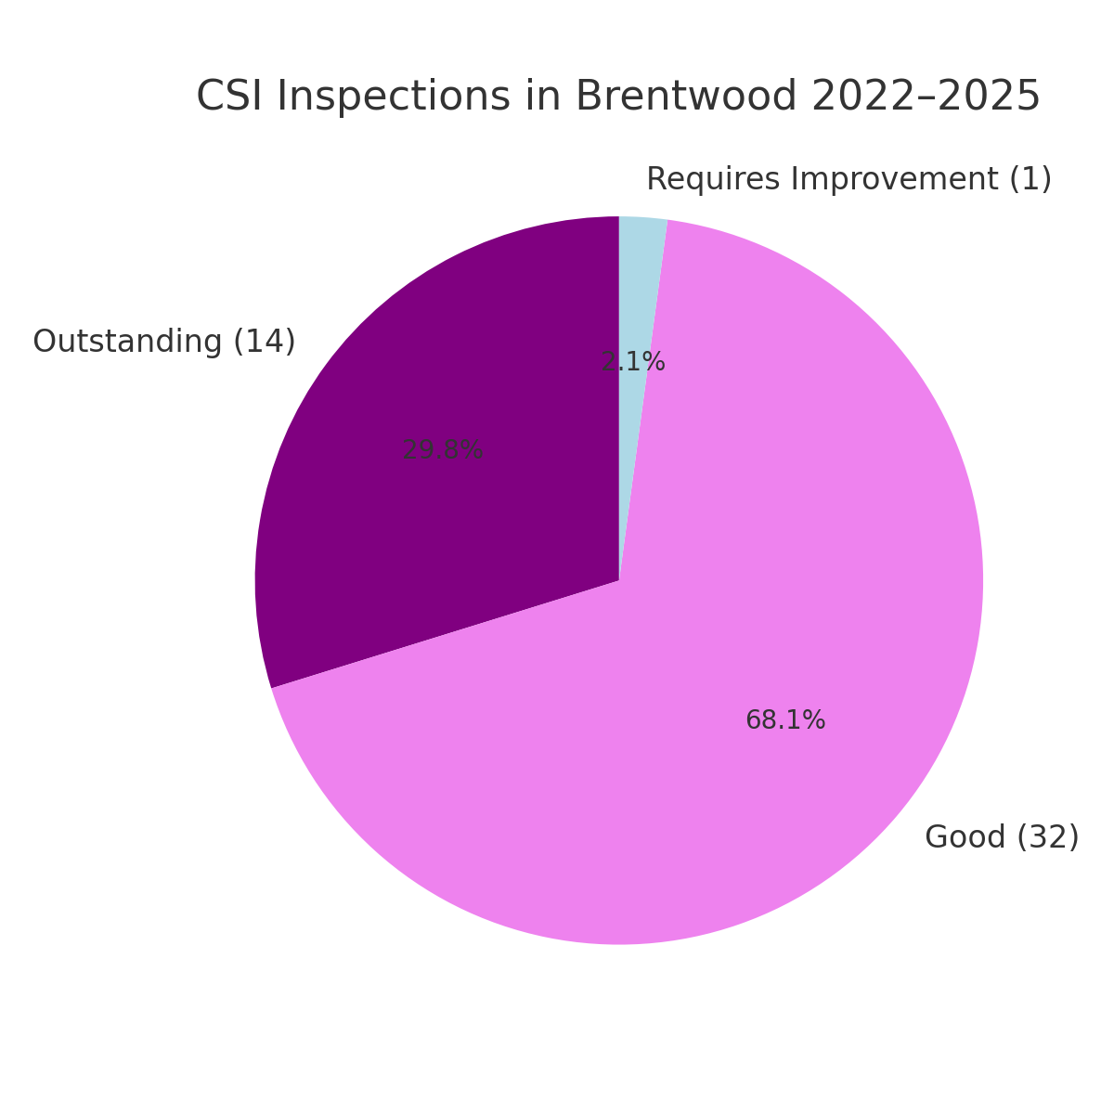

Slide 71
CLM1
CLM2
CLM3
Identity, charism & mission
Sense of worth
Moral development
Catholic Social Teaching
Respect for self & others
Chaplaincy
Identity, charism & mission
Staff commitment
Sense of community and inclusivity
Staff as role models
Pastoral care
Physical environment
Chaplaincy (pupils and staff)
R(S)HE
CLM in school policy
Engagement with diocese, including parish
Partnership with parents
Commitment to CST
Respect for the rights & dignities of employees
Catholic curriculum
Governors’ ambition
Self and pupil evaluation
CPD and induction of new staff
Catholic life and mission
Notes:
NC – we will be using these charts for each of the inspection areas. They are really useful overview sheets in so much as they show the coverage of each area and describe each inspection sub area as a simple sentence. Example let's look at identity charism and mission in outcomes and provision. It is a great way to split areas for individual inspectors to lead on, and then report on when agreeing judgements. These slides can be blown up and printed out as an inspection coverage tool.
5

Slide 72
RE1
RE2
RE3
Development of knowledge, understanding and skills
Progress (inc. of groups)
Religious literacy
Knowledge recall and questions
Independence and concentration
Quality of pupil work
Engagement and enjoyment
Self-assessment
Attainment
Subject & pedagogical knowledge
Expectations
Planning
Effective questioning
Celebration and feedback
Spiritual and moral development
Variety and resources
RED
Core parity
CPD
Subject Leader
Curriculum design
Pupils’ needs
Enrichment
Self-evaluation
Religious education
Notes:
NC
This is overview grid for RE. Really useful to show the coverage of the inspection area. Let's look at the quality of pupil's work and how clear the grading is. (RE 1 outstanding GD) In provision quick look at celebration and feedback. This grid can also help in summarising best fit judgements for feedback.
5

Slide 73
CW1
CW2
CW3
Pupil engagement
Pupil participation
Collaborative planning
Pupil leadership
Pupil evaluation
Influence on school life & curriculum
Impact
Centrality
Daily pattern & rhythm
Variety
Use of Scripture
Staff skill & role modelling
Creativity, use of space
Involvement of families and parish(es)
Impact of policy
Strategy for development of skills & participation
Sacraments, Holy Days and other significant days
CPD & formation
Leaders’ knowledge and skill
Impact of leadership
Resourcing
Self-evaluation
Collective worship
Notes:
NC
The final overview grid sheet. Prayer and Liturgy has moved on so much from the past – Anecdote about secondary prayers at St Mary's. Saying the De Profundis or Hail Holy Queen without repetition, hesitation or deviation to avoid some awful punishment. Lead from CW3 into CW2 and this ensures the quality of outcomes! Read GD for pupil leadership.
5

Slide 74
The Synoptic Problem
Conclusion
Any questions?
Contact details: nancyconoboy@rcdow.org.uk
0207 798 9183 or 07710 088910
BDES

